Slide 1
Research Compensation:
All the Ways to Pay
https://ora.mines.edu
https://maps.mines.edu
https://www.mines.edu/graduate-studies/
https://www.mines.edu/bursar/

Slide 2
Why We Are Here Today
Key Takeaways
Purpose
Differences between an employee and non-employee
RA tuition needs to be proportionate to pay
To provide a better understanding of the different types of compensation, especially as it relates to research
How to process Participant Support & REU payments

Slide 3
Employees vs Non-Employees
Non-Employees
Stipends or Non-Service Stipends
Employees
Salaries or Service Stipends*
There is an expectation of services or deliverables
There is NO expectation of services or deliverables
Processed by Payroll
Payroll taxes are withheld
Receives a W-2 in January
Processed by AP
No taxes are withheld
Receives a 1099/1098-T in January
*Service Stipends are exclusive to graduate RA and TA students as part of the graduate student’s contract

Slide 4
Employees vs Non-Employees
Non-Employees
Stipends or Non-Service Stipends
Employees
Salaries or Service Stipends
Faculty
REU Students
Staff
Hourly (including Grad & UG students)
Participants
Graduate RAs & TAs
Fellowships
Honorariums

Slide 5
The Importance of Accuracy
Classification has tax implications
Cannot correct previous calendar years due to reporting to IRS
Certain research award agreements have restrictions
Expenses may be unallowable if paid incorrectly
Adjustment of indirect costs may over or under spend an award
Funds may be owed back to Mines if compensated incorrectly

Slide 6
EMPLOYEES:
Submitting Contracts & Pay Process

Slide 7
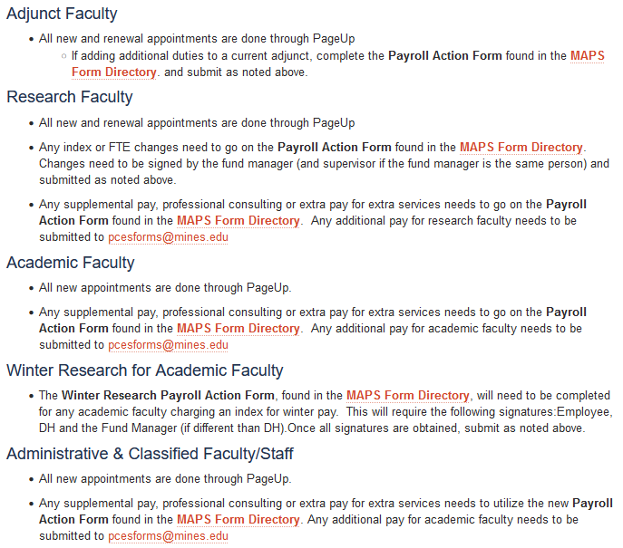
Academic, Research, & Other Faculty
Information related to routing and approval of faculty forms can be found at:
https://helpcenter.mines.edu/TDClient/2657/maps/Requests/ServiceDet?ID=46109
PageUp is used for new and renewal appointments
Payroll Action Form is used for:
Index or FTE Changes
Supplemental Pay
Professional Consulting or Extra Pay for extra services

Slide 8
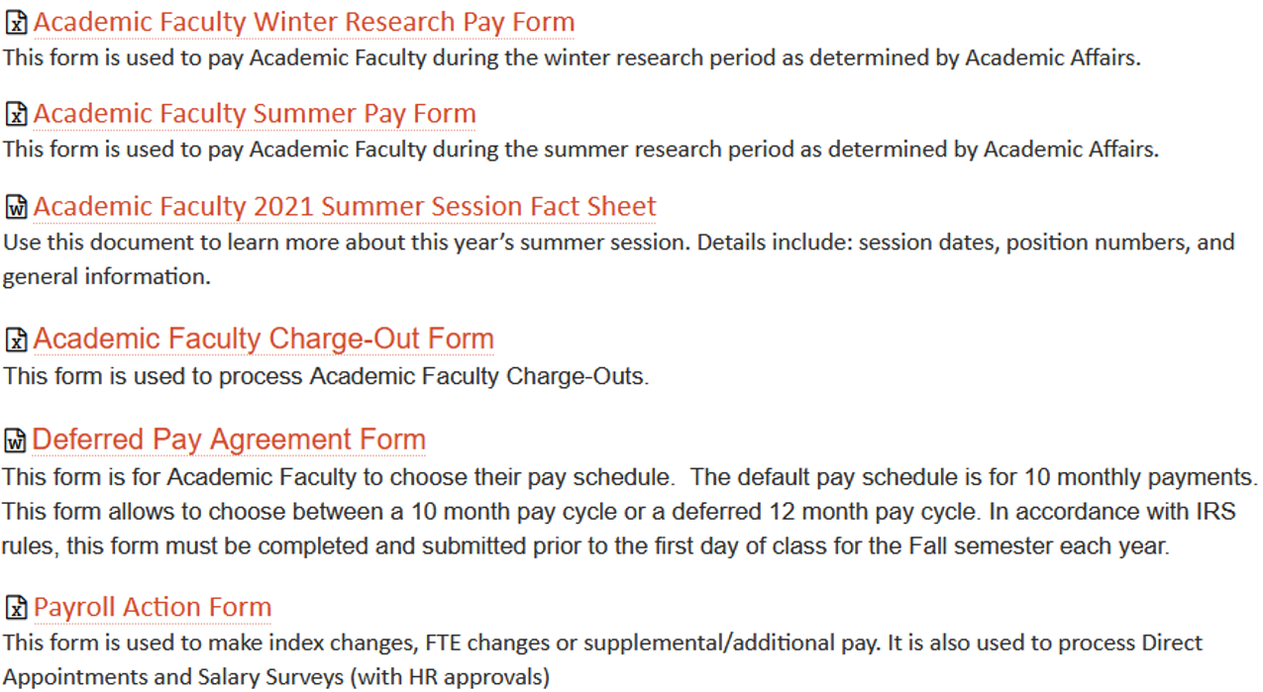
MAPS Forms Directory

Slide 9
Graduate RAs & TAs
Position | Type & Compensation Mechanism | Description | To Request | Acct. Code | Things to Note
Graduate Research Assistant | Employee Salary Service Stipend Payroll | Research Assistantships (RAs) are students supervised by faculty members to perform research that is associated with a student's area of study. Work is technical, requires significant education and is directly related toward meeting the student's thesis-based degree program, but may include assignments that are peripheral toward meeting degree requirements. | Graduate Contract Form OnBase | Pay: 5214 Tuition: 5118 | Student contracts are submitted on a semester basis. Tuition is considered fringe & should be proportionate to pay. Tuition is processed on a semester basis by the Bursars. Student is compensated semi-monthly through payroll.
Graduate Teaching Assistant *Uncommon as allowable on research grant- confirm allowable w/ Research Accountant prior to submission* | Employee Salary Service Stipend Payroll | Teaching Assistantships (TAs) are for students who assist in the education of other students under direction of a faculty member. | Graduate Contract Form OnBase | Pay: 5213 Tuition: 5119 | Student contracts are submitted on a semester basis. Tuition remission is standard and determined by department. Tuition is processed on a semester basis by the Bursars. Student is compensated semi-monthly through payroll.

Slide 10
Graduate RA & TA Tuition
Must be proportionate among ALL indexes if one or more relates to research (4XXXXX)
Allowable and standard on RA & TA contracts
RA / TA Salary Service Stipend is required in order to cover tuition

Slide 11
Graduate RA & TA Tuition
Original Contract:
Amended Contract:
Tuition is allowable and standard on RA & TA contracts
There needs to be pay in order to have tuition
Tuition must be proportionate among ALL indexes if one or more relates to research (4XXXXX)

Slide 12
Revising RA Contracts
Grad Contract Changes - Research
Current Semester
Previous Semester
Submit Payroll Reallocation
ORA will reallocate tuition proportionate to pay
Amend Contract in OnBase
Future Changes Only
Past or Past & Future Changes
Indexes updated in Banner for future pays
Indexes updated in Banner for future pays
Tuition reallocated proportionately
Tuition reallocated proportionately
Submit Payroll Reallocation for changes needed to pay already processed

Slide 13
Hourly Students
Position | Type & Compensation Mechanism | Description | To Request | Acct. Code | Things to Note
Hourly (Graduate Student) | Employee Hourly Pay Rate Payroll | Part-time on campus work in areas that are unrelated to a student's academic program and does not involve teaching or research duties of the nature expected of a RA or TA. Student may provide clerical, administrative and technical support for academic and administrative units and individual Mines faculty and research units. | Graduate Contract Form OnBase | Pay: 5218 | Hourly contract may be prepared to cover multiple semesters, inter-terms, both, or a full academic year. No benefit of tuition reimbursement. Student is compensated semi-monthly through payroll.
Hourly (Undergraduate Student) | Employee Hourly Pay Rate Payroll | Undergraduate students working on campus. | Undergraduate Student Employment Form | Pay: 5218 | Hourly contract may be prepared to cover multiple semesters, inter-terms, both, or a full academic year. No benefit of tuition reimbursement. Student is compensated semi-monthly through payroll.
 |  |  | MAPS Ticket: Submit NEW Undergraduate Student Contract

Slide 14
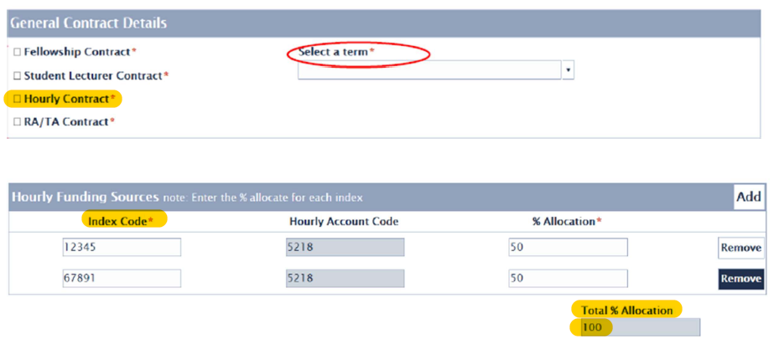
Hourly Students: Graduates
Contract is submitted in OnBase
Tuition / Fees / Insurance is unallowable
Acct Code: 5218

Slide 15
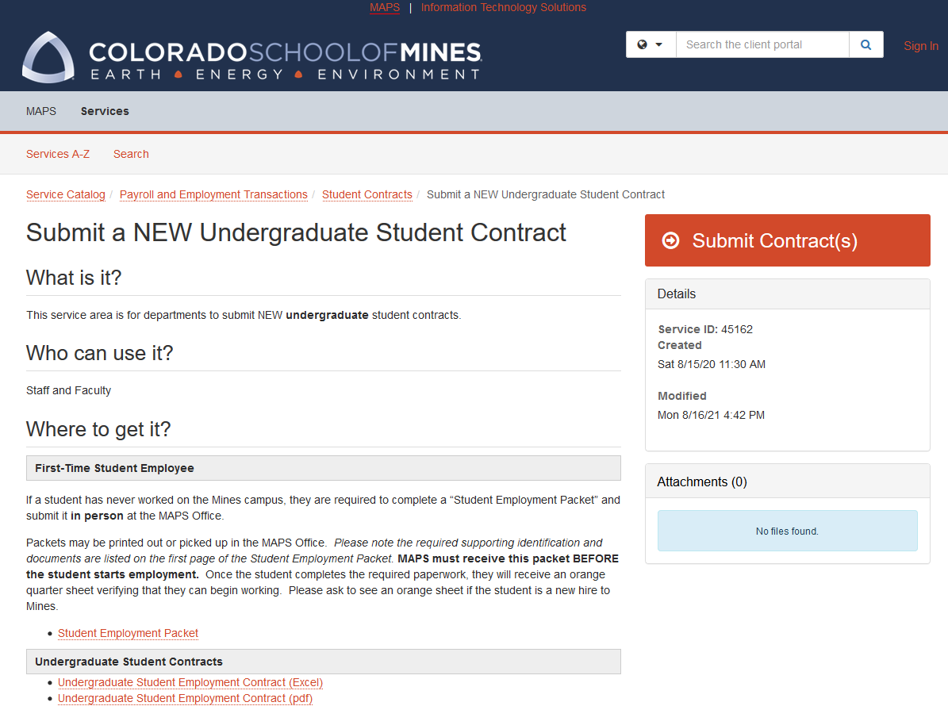
Hourly Students: Undergraduates
Contract is submitted as a MAPS ticket
Tuition / Fees / Insurance is unallowable
Contract template (PDF & Excel) can be found on MAPS ticket
Acct Code: 5218

Slide 16
Common Scenarios
1. Alex's RA contract is set up to pay 100% of the salary service stipend using an NSF grant and T/F/I is charged to the PI's RD index.
Is Alex's contract set up correctly?

Slide 17
Common Scenarios
Answer to #1:
No. Alex cannot be paid 100% from one research index and have all T/F/I charged 100% to a different index. The contract needs to be corrected to show one of the following:
100% pay & 100% T/F/I to the NSF grant or PI's RD
Pay and T/F/I proportionate between NSF & PI's RD

Slide 18
Common Scenarios
2. Jamie's fall RA contract was set up to the wrong index and it was discovered the first week of November.
What are the steps to correct?

Slide 19
Common Scenarios
Answer to #2:
Because the error was discovered in the current semester and pay has posted to the wrong index, there are two steps:
1. Amend Jamie's contract in OnBase for fall semester
Revises future pays
Tuition reallocated
2. Submit a Payroll Reallocation for pay periods 17-20

Slide 20
Common Scenarios
3. Sam, an hourly student, has been doing a great job working on a DOE project. The PI would like to pay 50% of Sam's T/F/I for the upcoming semester.
Is this allowable?

Slide 21
Common Scenarios
Answer to #3:
No. Sam is an hourly student employee and T/F/I is not allowable on the project – either as a grad or undergrad student.
*If Sam is a graduate student, the supervisor could choose to prepare an RA contract in future that includes both a salary service stipend and T/F/I or award a fellowship from a non-research index that could be applied to T/F/I.

Slide 22
Common Scenarios
4. For the past 3 semesters Morgan has been a RA for a professor who now also needs help with a new course they are teaching.
Morgan's professor requests a combined RA/TA contract for the upcoming semester for 15 hours/week on the research project and 5 hours/week as grader for the course.
The contract uses the research index for the RA salary service stipend and all T/F/I (as done in the past) and gives another index for the TA role.
Is this contract correct?

Slide 23
Common Scenarios
Answer to #4:
No. If Morgan is working 75% of the hours as an RA (15 of 20 hours), the research grant can only be charged only 75% of the T/F/I.
The remaining proportion of T/F/I must be covered by a non-research index.

Slide 24
Non-Employees:
Submitting Contracts & Pay Process

Slide 25
Types of Non-Employee Payments
Federal REU Programs
Payment for participating in a training or learning opportunity in the participants areas of research.
Participant Support
Award provided to an individual to offset the cost of education.
Graduate Fellowships
Honorariums
Compensation made as a "thank you" and gesture of goodwill and appreciation. Usually used for a guest speaker or lecturer.
Research Experiences for Undergraduates (REU) programs supports active research participation by undergraduate students
This is not the Mines REU program
Fellowships posted on a research program must be part of a formal fellowship program identified by the Sponsor.

Slide 26
Graduate Fellowships
Position | Type & Compensation Mechanism | Description | To Request | Acct. Code | Things to Note
Graduate Fellowship | Non-Employee Non-Service Stipend Bursars & Financial Aid | Graduate Fellowship awards are made without the expectations of services being rendered. Fellowships posted to sponsored research must be part of a formal fellowship program identified by the Sponsor. | Graduate Contract Form OnBase | Stipend: 5565 Tuition: 5566 | Fellowship appointments are submitted on a semester basis. Fellowship program may or may not allow for tuition; refer to award or contact the Research Accountant. Stipend and tuition is processed by Financial Aid & Bursars Office.

Slide 27
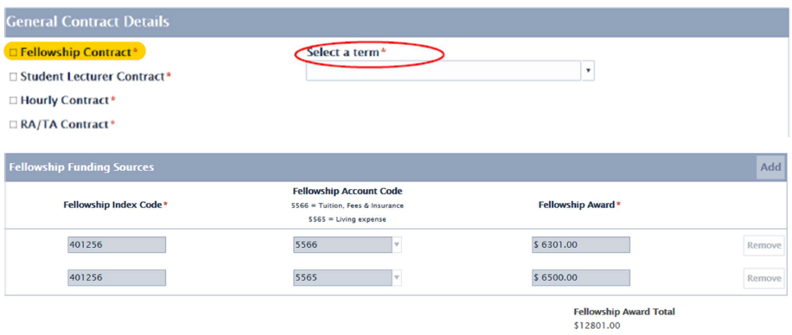
Graduate Fellowships
Contract is submitted in OnBase
Fellows are often appointed through a formal program
Acct Code: 5565 – Stipend
5566 – T/F/I
55 545
5555

Slide 28
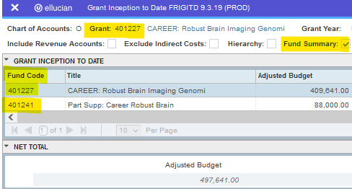
Participant Support & REU Award Set-up
When we receive an award that has Participant Support or a REU supplement, there will be multiple indices associated with this award.
Grant Index = Primary Index
Fund Index = Participant Support index or REU index
In CRS (under Index Information):
In Banner:

Slide 29
Participant Support/REU Award Set-up:
In COGNOS:

Slide 30
Participant Support
Position | Type & Compensation Mechanism | Description | To Request | Acct. Code | Things to Note
Participant Support | *Non-Employee MAPS / Accounts Payable | Individual participates in a formal program intended to support a training or learning opportunity from a workshop, conference, seminar, symposium or other short-term instructional or information sharing activity funded by a sponsored award. Participants do not perform work or provide any service to the university in return for this support costs. | MINES Student Participant Agreement and Payment Request Form | Stipend: 5863 Housing: 5864 Supplies: 5865 Travel: 5866 Other: 5867 | May or may not be a Mines student. A participant cannot be receiving salary/wages from the main award index but can be a Mines employee. Compensation is issued as a stipend and may also cover housing, travel, supplies, or other expenses.
 |  |  | Non-MINES Student Participant Agreement and Payment Request Form MAPS Participant Agreement and Payment Request
* A Mines Employee who is not receiving a salary/wage on the primary grant and is not providing any support to the training/learning opportunity but participates in the learning opportunity is eligible to receive a participant support payment.

Slide 31
REU Supplemental Awards
Position | Type & Compensation Mechanism | Description | To Request | Acct. Code | Things to Note
REU: Research Experiences for Undergrads | Non-Employee MAPS / Accounts Payable | Program for eligible undergraduates to participate in research. This a special type of participant support. Requires a supplemental award from sponsor. | MINES Student Participant Agreement and Payment Request Form | Stipend: 5582 Housing: 5864 Supplies: 5865 Travel: 5866 Other: 5867 | May or may not be a Mines student. The Student CANNOT be a Mines employee. Student must be a U.S. citizen or permanent resident. Compensation is issued as a stipend and may also cover housing, travel, supplies, or other expenses.
*Not the Mines REU Program* |  |  | Non-MINES Student Participant Agreement and Payment Request Form MAPS Participant Agreement and Payment Request

Slide 32
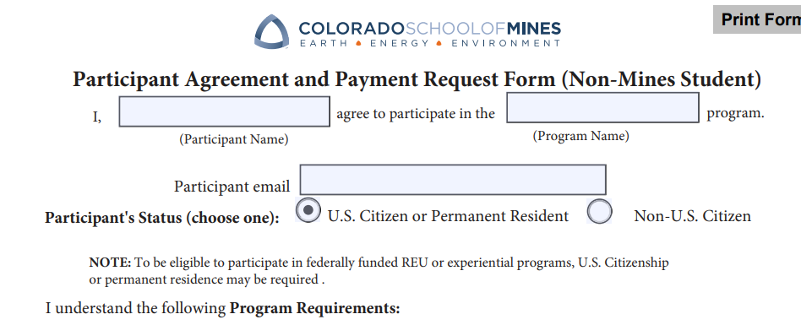
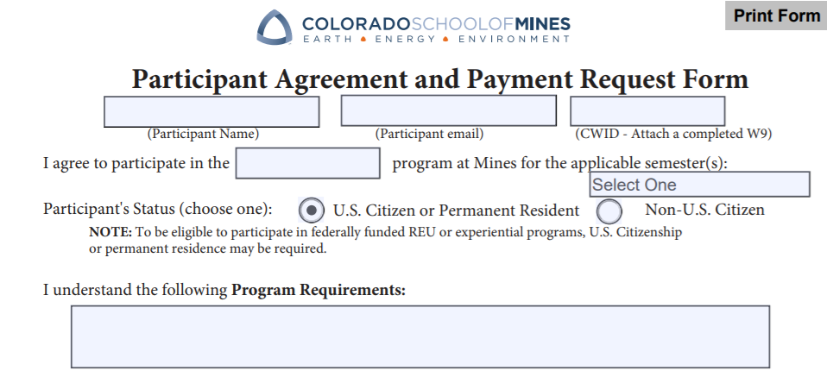
Participant Support / REU Agreement and Payment Request
Submit using a MAPS service ticket
Select form based on whether a Mines or Non-Mines student
Acct Codes:
Participant Support Stipend: 5863
REU Stipend: 5582 Housing: 5864 Supplies: 5865 Travel: 5866 Other: 5867
545
5555
Non-Mines Student:
Mines Student:

Slide 33
Participant Support / REU Acct Codes:
5864: Housing
5582: REU Stipend
5863: Participant Support Stipend
5865: Supplies
5866: Travel
5867: Other
For the participant's use
For the participant's airfare, hotel, and per diem
Local participants are not entitled to these reimbursements
Examples are training materials or laboratory supplies
Catering for participant workshop or conference
Misc Fees such as lab usage, registrations, and/or passport or visa fees for foreign participants
For long term housing
Local participants are not entitled to these reimbursements
Cannot be a Mines employee already being paid from the main project
For undergraduate students; can be a Mines or non-Mines student
Payment made through AP
Payment is made through AP

Slide 34
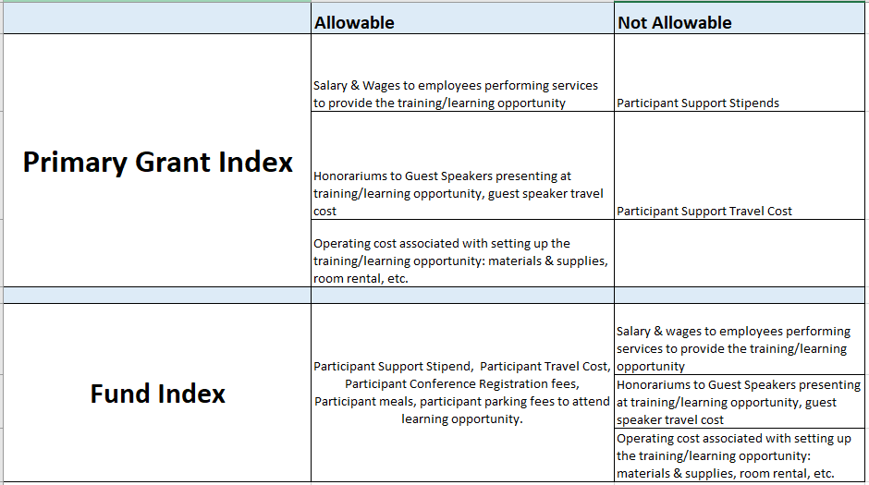
Participant Support:
What can I spend on the Primary Grant Index vs the Fund index?

Slide 35
Honorarium
Position | Type & Compensation Mechanism | Description | To Request | Acct. Code | Things to Note
Honorarium | Non-Employee MAPS / Accounts Payable | An honorarium is a token payment, or reward made to an individual for a one-time service (e.g., a guest lecture) for which custom forbids a price to be set. | Voucher Request Form MAPS Voucher Payment Request | Honorarium: 5312 | May not be receiving a salary/wage from Mines. There must not be an expectation of payment. Service is voluntary and there is no negotiated services or price. If a negotiated service & price exist, then the scope is an independent contractor. The appropriate procurement procedures must be followed.

Slide 36
Common Scenarios
5. May is paid a RA salary on an NSF grant. The NSF grant also has a participant support budget. Part of May's role is to assist in coordinating a workshop related to the participant support fund.
Is May eligible to receive payment from the participant support budget?

Slide 37
Common Scenarios
Answer to #5:
No. May cannot be paid a stipend from the Participant Support budget because she is already receiving a RA Salary from the NSF Grant (primary).
The participant support budget are funds allocated to participant support costs.

Slide 38
Common Scenarios
6. Professor Li from CU has been invited to speak at a workshop funded by a grant. After the presentation, our department would like to pay Professor Li an honorarium of $500.
Can we use the participant support budget to pay for this honorarium?

Slide 39
Common Scenarios
Answer to #6:
No. Honoraria expenses to pay for speakers presenting at a workshop are not allowable as participant support costs.
This can be budgeted and charged as a direct cost item on the primary award.

Slide 40
Common Scenarios
7. Arjun is a MINES student who is a part of the NSF Research Experiences for Undergraduates program. To pay him on the project, should the department set him up as an hourly student employee?

Slide 41
Common Scenarios
Answer to #7:
No. The department should complete the MAPS "Student Participant Agreement and Payment Request Form" and submit the form to MAPS using account code 5582 "REU Stipend". The form will route to ORA for approval.

Slide 42
Conclusion:
Key Takeaways
Employee vs Non-Employees
Tuition Proportionate to
RA Pay
Appropriate Pay Mechanisms
Allowability on Participant Support & REU grants
Appropriate Account Codes
Tax Implications

Slide 43
Resources
Research Compensation Matrix
https://ora.mines.edu/home/manage-award/post-award/
Graduate Assistantship Policies
https://www.mines.edu/graduate-studies/graduate-assistantship/
Graduate Contracts Training & Documentation
https://www.mines.edu/graduate-studies/graduate-contracts/
MAPS Participant Support (REU) Request Ticket
https://helpcenter.mines.edu/TDClient/2657/maps/Requests/ServiceDet?ID=45179
MAPS Payroll Reallocation Ticket
https://helpcenter.mines.edu/TDClient/2657/maps/Requests/ServiceDet?ID=45213
Routing & Approval Process for Faculty
https://helpcenter.mines.edu/TDClient/2657/maps/Requests/ServiceDet?ID=46109

Slide 44
Questions?
Postaward@mines.edu

