Slide 1
CRS, Research, And you

Slide 2
CRS Agenda - Proposals
What is CRS?
What’s new?
How do I login?
How do I start a proposal?
How will proposal routing and approval work?

Slide 3
What is CRS?
CRS stands for Contract & Research System
Web-based platform for proposal & award management
Electronic proposal tracker, router and certification
Proposal & award reporting system (college, dept, center, PI, sponsor, etc.)
Banner still handles expenses & financials

Slide 4
New in Pre-Award
Generate Current & Pending Support documents
Start & route Cost Share Approvals & IDC Waivers (no more paper)
Start & route At-Risk Spend Requests (no more paper)
Track status of proposals & at-risks
New in Post-Award
Track status of projects, at-risks & sub-awards
Certify & monitor Academic Year (AY) Cost Share
View terms & conditions & reporting requirements
Approve subcontractor invoices
View award amounts & cost share
New in Consortia
Track status of consortia & consortia contracts
View improved member payment & invoice section

Slide 5
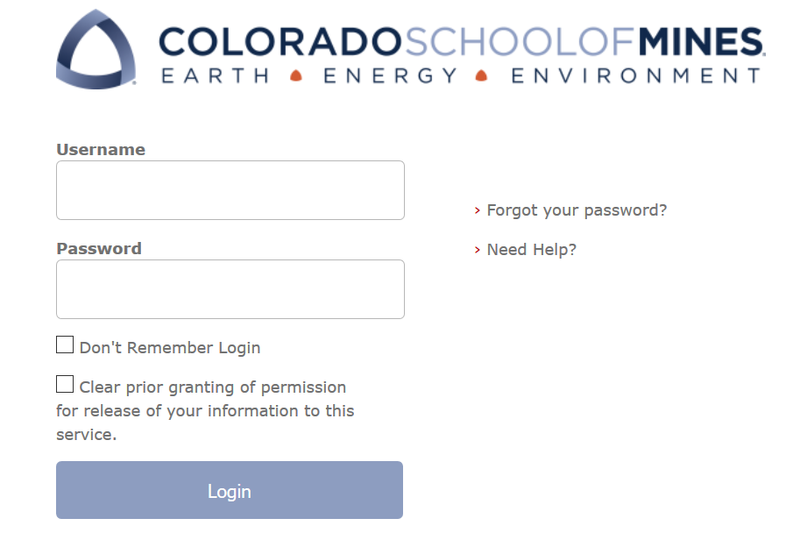
Log on Information
URL
coming soon
will be posted at ora.mines.edu
Username: Password:
Use Mines Multi-pass credentials (single sign on)

Slide 6
CRS Home Page
Research Actions
Procurement
Find CRS Data
Approvals

Slide 7
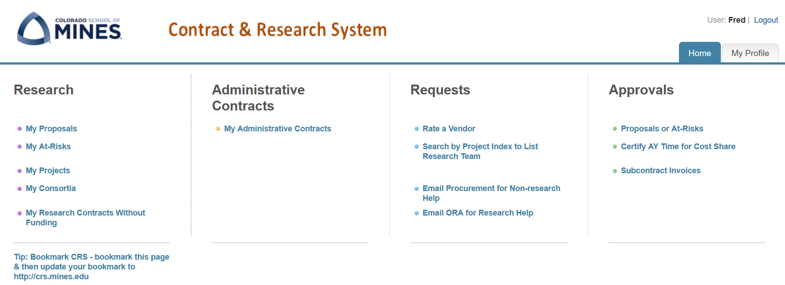
Where Do I Start?

Slide 8
My Proposals

Slide 9
My Proposals: Status
Possible statuses:
Draft
Proposal Preparation
Routing
Funded
Withdrawn
Not Submitted
Not Funded

Slide 10
My Proposals
New: Starts a new Proposal record
Views: Do not use. Campus & ORA share a common view
Search: Search for a particular Proposal record – co-PI, title, sponsor, dept/center
Copy Proposal: You can Copy an old proposal and update the data to make a new Proposal record
Actions: Export Proposal records to your computer via MS Excel

Slide 11
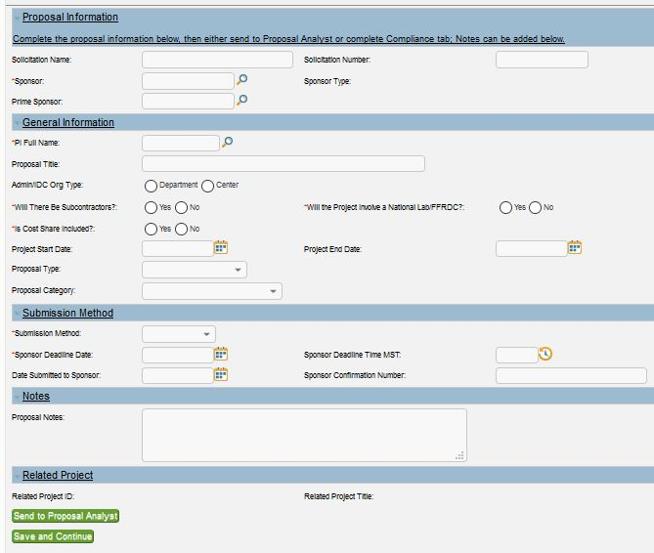
Proposal Data
After selecting ‘New’, you need just 7 points of data to start a proposal:
Notes = Extra Credit
Send to Proposal Analyst OR complete Compliance tab & then send to Proposal Analyst

Slide 12
Team Tab
Click New to add PI & co-PIs

Slide 13
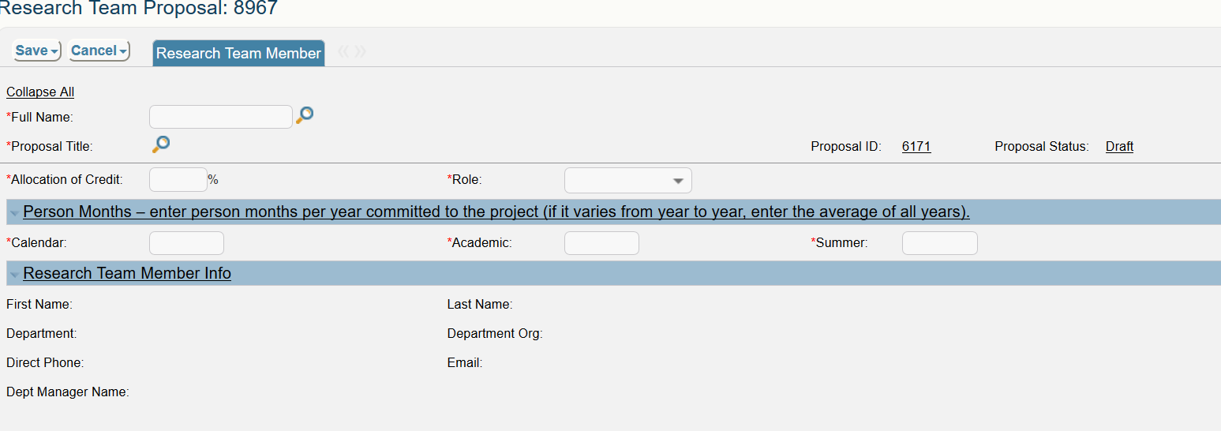
Team Tab
Use the magnifying glass to search for & add Mines faculty
The Allocation of Credit should total 100%
Role = PI, co-PI, Senior Personnel, & Postdoc
Person Months needs to have at least a value of zero in all fields
Research Faculty = calendar months
Academic Faculty = academic effort if they have cost share
Academic Faculty = summer months

Slide 14
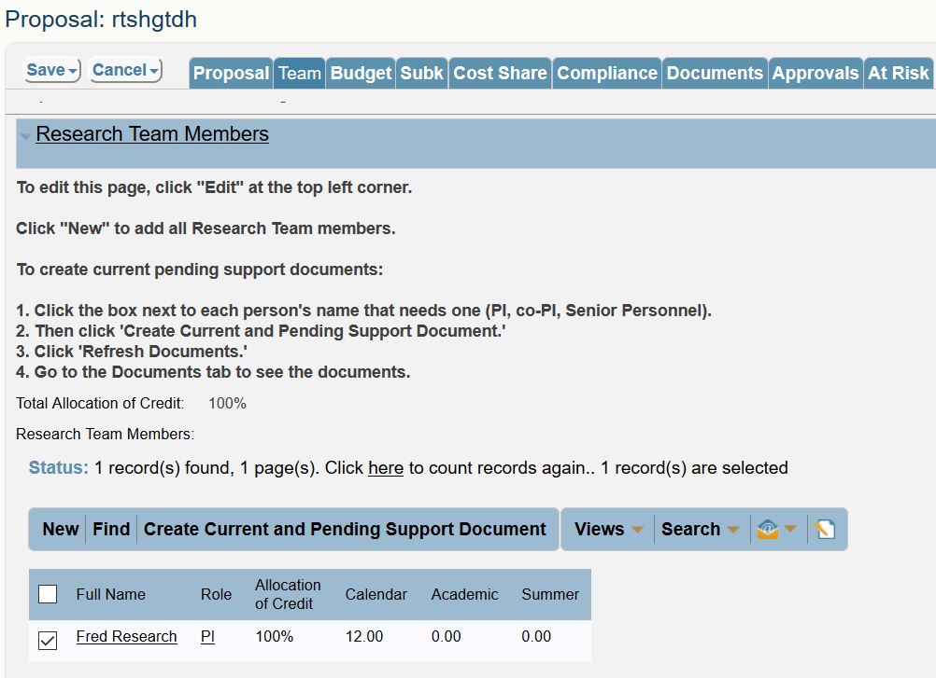
Current & Pending Document
During the proposal draft stage, faculty can generate their own Current & Pending Support document in CRS by going to the “Team” tab and checking their name.
Note – this can only be done when proposal is in “Draft” or “Proposal Preparation.”

Slide 15
Current & Pending – Documents Tab

Slide 16
Budget
Years 1-5
Total Budget
View only access to Budget. Proposal Analyst will enter budget information.

Slide 17
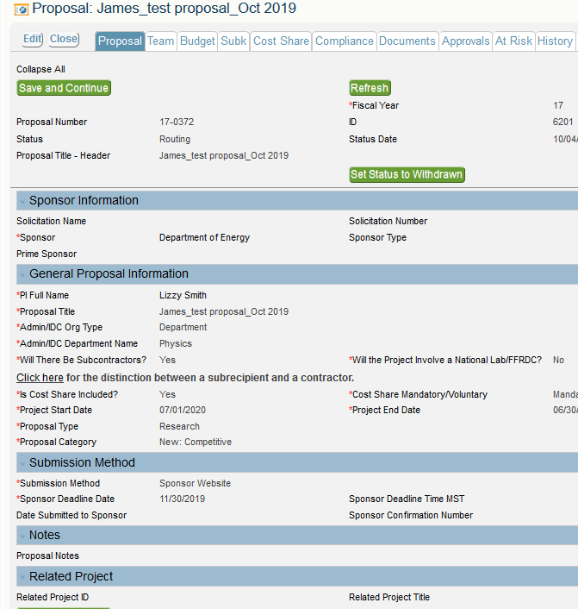
Subk & Cost Share
Subk & Cost share tabs appear at the top when ‘Yes’ is answered to these questions on the Proposal tab
Otherwise, they remain hidden

Slide 18
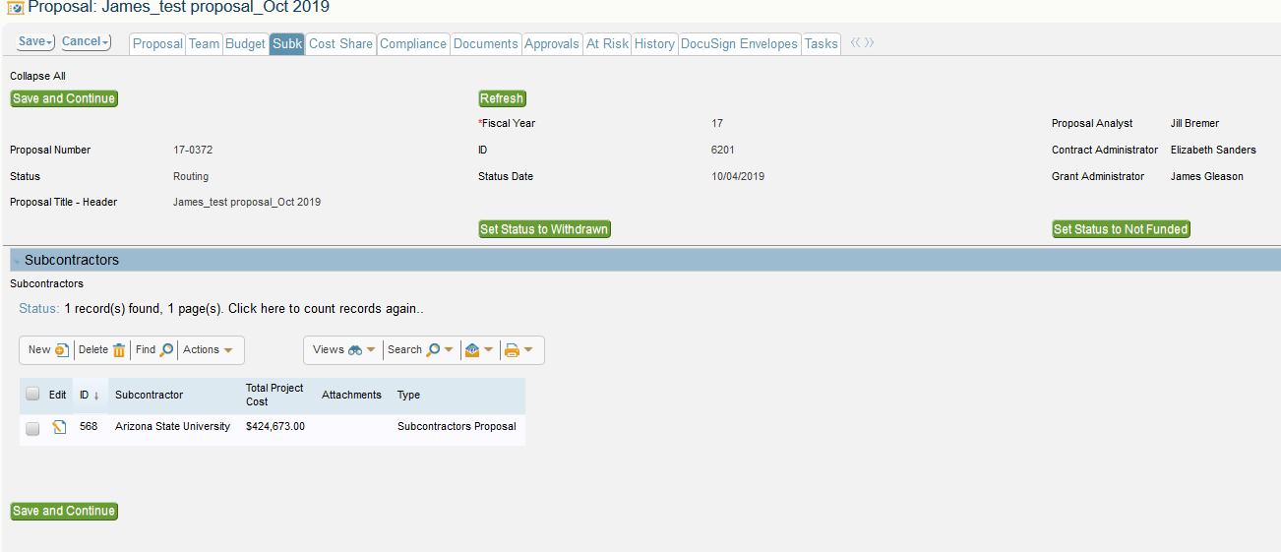
Subk
This record has 1 subcontractor – ASU
Click new to add a subcontractor

Slide 19
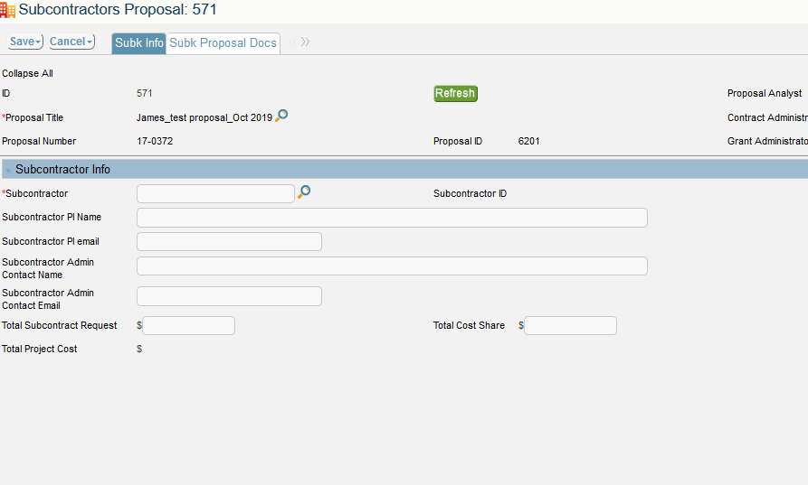
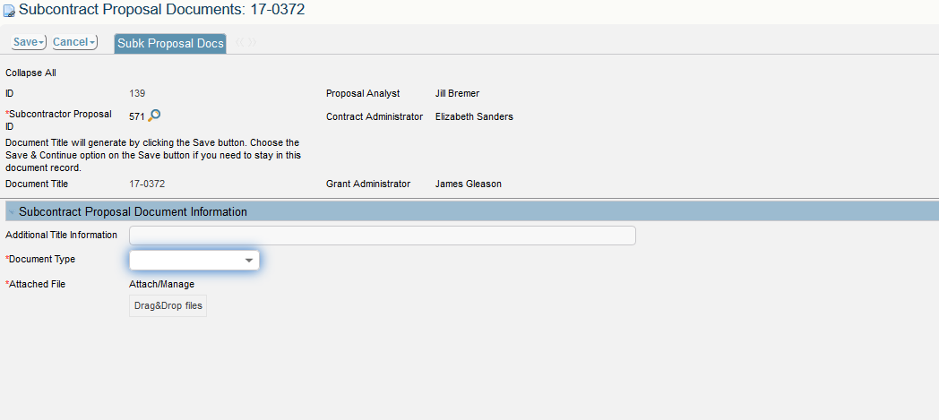
The magnifying glass allows you to search for sponsors.
Add subcontractor documents 1 at a time.

Slide 20
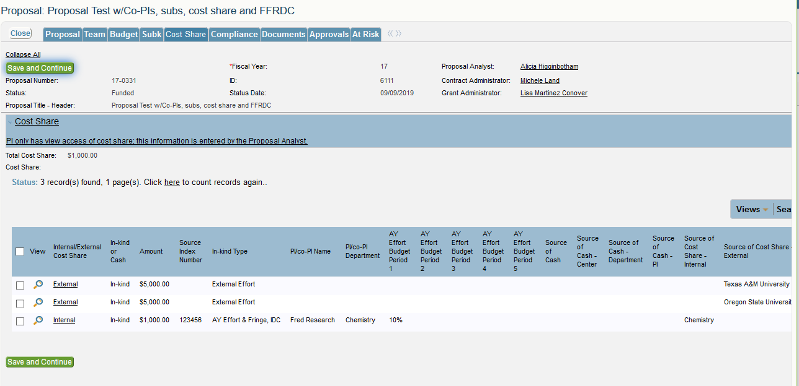
Cost Share
View only access to Cost Share –
Proposal Analyst will enter the information & data

Slide 21
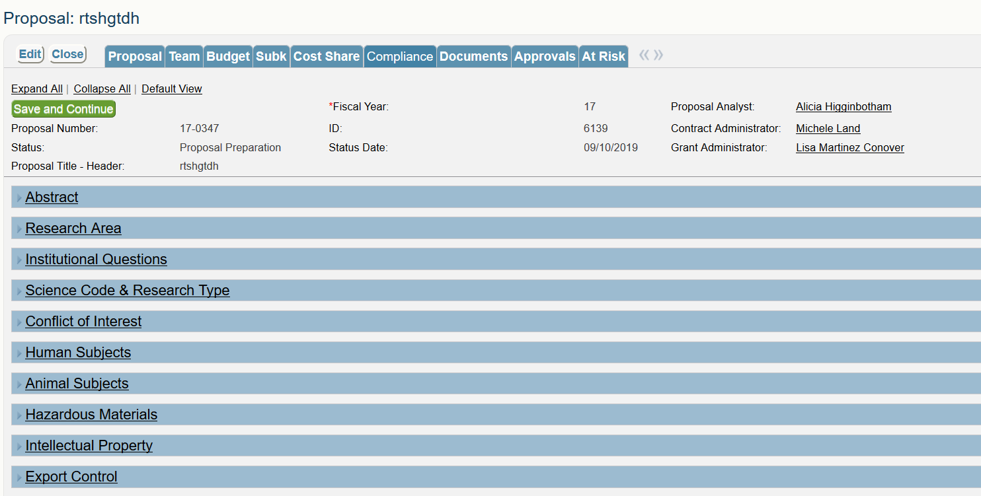
Compliance
All Compliance questions are required for each proposal & must be completed before routing.

Slide 22
Send to Proposal Analyst
Located at the bottom of 2 tabs:
Proposal tab
Compliance tab
If the Compliance tab is completed by the PI, the Proposal Analyst can upload documents and start the routing process
If the Compliance tab is not completed, then the Proposal Analyst can continue working in the proposal and route once the Compliance questions are answered

Slide 23
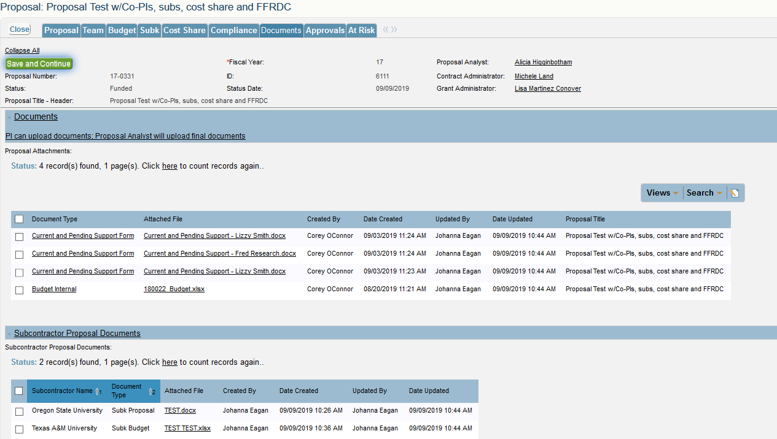
Documents

Slide 24
Approvals

Slide 25
Approvals
Related To: shows Proposals & At-Risk Spending Requests in the PI’s queue
Approval Title: Identifies if you are approving as
PI (either PI/co-PI or PI Approval)
Center Director or Dept Head (Unit Approver)
Clicking on a hyperlink takes you into the proposal for review

Slide 26
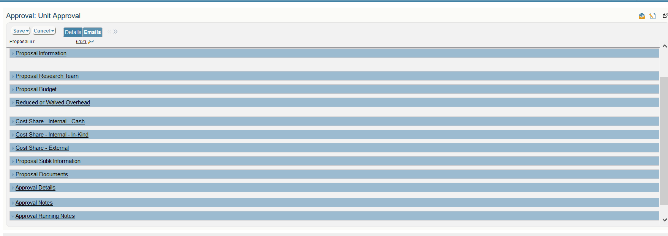
Approvals
Each section opens to show further details

Slide 27
Approvals: Reduced Overhead

Slide 28
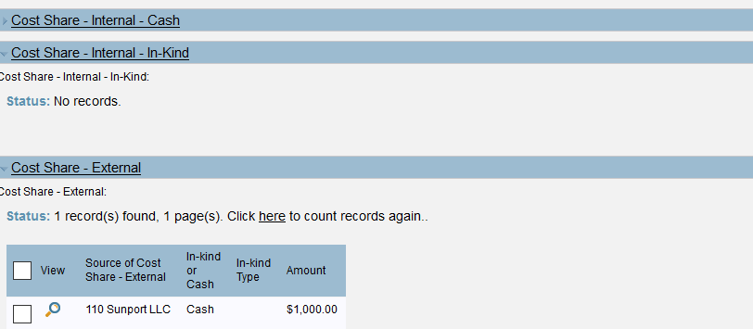
Approvals – Cost Share
Click the section header name to view further info in that section.
Click the magnifying glass to see all details about a cost share entry.

Slide 29
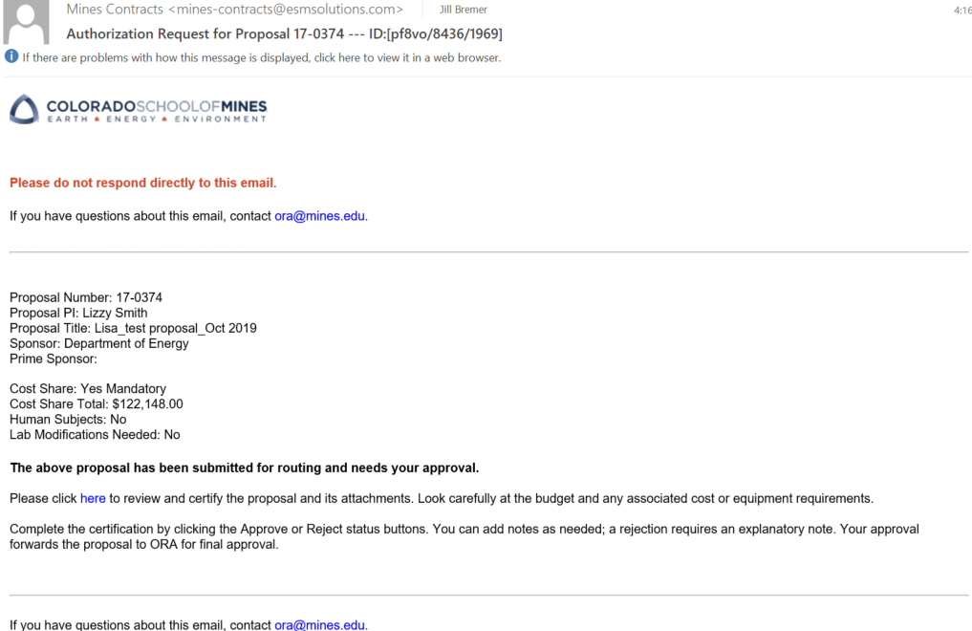
Approvals - Email

Slide 30
Approvals
Approve: allows you to approve the record
Request Info: allows you to ask questions/seek clarification prior to making an approval. ORA receives an email & can help answer the question.
Reject: does not authorize the proposal
Notes: make comments about your approval. Notes stay with the approval record.

Slide 31
Re-directing Approvals

Slide 32
Re-directing Approvals
Designate a backup person once, the system will remember through the date provided!

Slide 33
Re-directing Approvals

Slide 34
Cayuse > CRS Transition
CRS launches end October
All Cayuse data will transition to CRS
Documents may not be immediately available in CRS, but ORA can email them
Banner remains financial repository for data
Once CRS is launched, Cayuse will be inactive
Watch for CRS ‘go-live’ alerts in the Daily Blast & via the Research Listserv

Slide 35
Browser Information
Works best in Firefox (fully compatible)
iPhone, iPad & Droid enabled (convenient for approvals)
Need
Javascript enabled
Cookies enabled
Pop-ups allowed

Slide 36
Questions?

Slide 37
Thanks for Coming!
More CRS trainings on ORA website
Proposals, Contracts, Post-Award, Consortia Management, Program Administrators, Walk-ins
CRS Manuals & Training Slides will post to our website! Ora.mines.edu

