Slide 1
CRS, Research, And you

Slide 2
CRS Agenda – Post Award
What is CRS?
What’s new?
How do I login?
Where do I see Project Details?
How do I find my index?
Where is my Award?

Slide 3
What is CRS?
CRS stands for Contract & Research System
Web-based platform for proposal & award management
Electronic proposal tracker, router and certification
Proposal & award reporting system (college, dept, center, PI, sponsor, etc.)
Banner still handles expenses & financials

Slide 4
New in Pre-Award
Generate Current & Pending Support documents
Start & route Cost Share Approvals & IDC Waivers (no more paper)
Start & route At-Risk Spend Requests (no more paper)
Track status of proposals & at-risks
New in Post-Award
Track status of projects, at-risks & sub-awards
Certify & monitor Academic Year (AY) Cost Share
View terms & conditions & reporting requirements
Approve subcontractor invoices
View award amounts & cost share
New in Consortia
Track status of consortia & consortia contracts
View improved member payment & invoice section

Slide 5
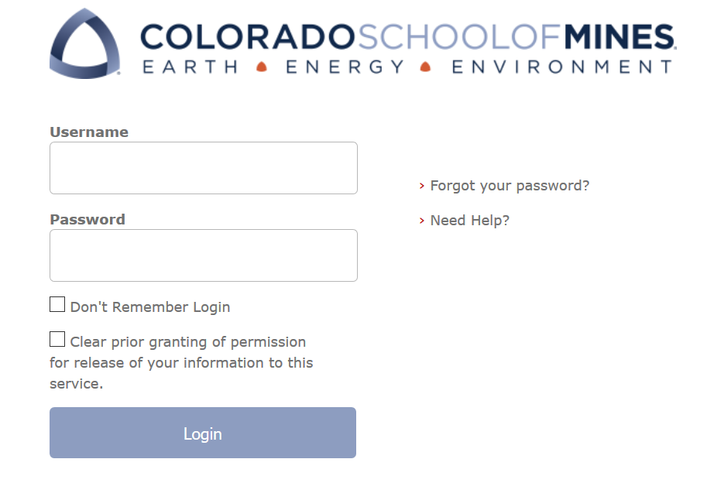
Log on Information
URL
coming soon
will be posted at ora.mines.edu
Username: Password:
Use Mines Multi-pass credentials (single sign on)

Slide 6
CRS Home Page
Research Actions
Procurement
Find CRS Data
Approvals

Slide 7
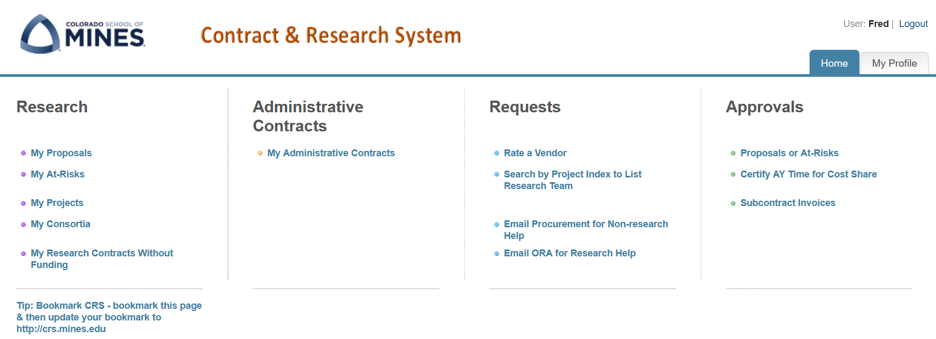
Get Started

Slide 8
My Projects
Shows all Projects
Sort by Column Headings
Hyperlinked fields take you to project details

Slide 9
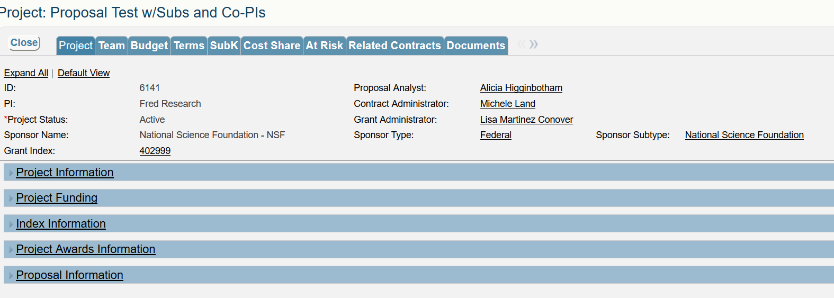
Project Data
Starting point for finding your Project details
Project Details include Project Information, Funding, Index(es), Awards Info, and Proposal Info

Slide 10
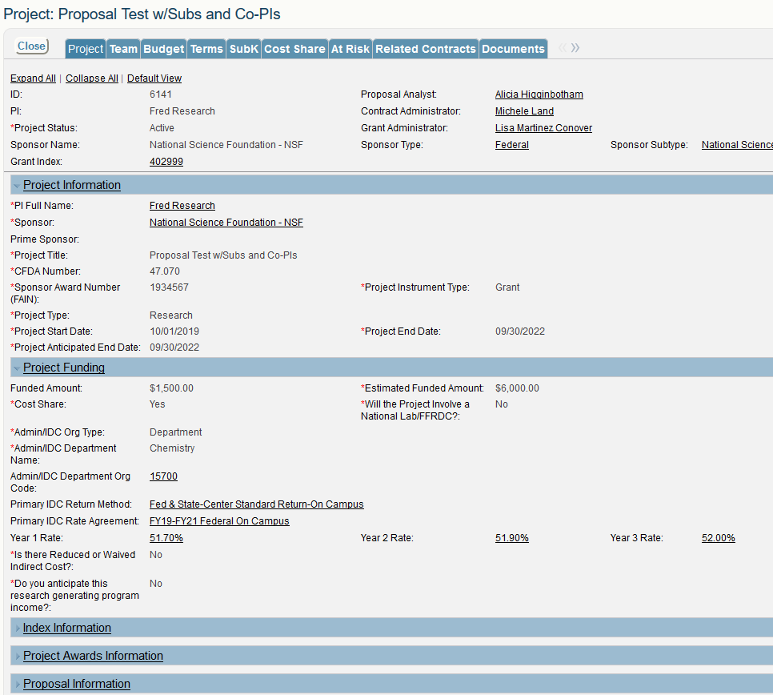
Notes:
Talking point:
- New estimated end that will let us know if the project is intended to past the current budget year
- Estimated funded amount – if we are incrementally funded the anticipated full project amount will show here.

Slide 11
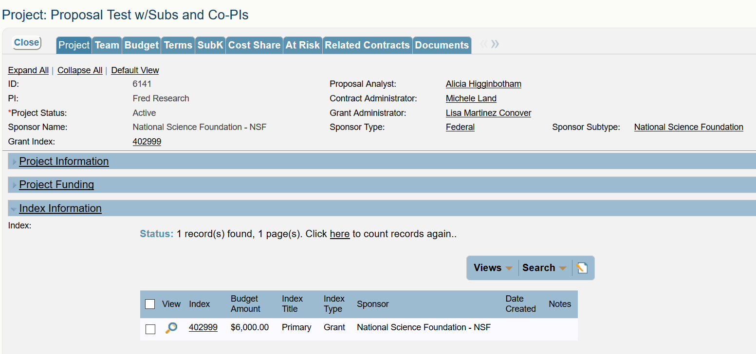
Index Information
All sources and uses of funds associated with the Project
All Indexes related to the Project will be shown including: cost share, participant support costs, primary, and Tech Transfer & Other

Slide 12
Index Details
The overhead rate and return method displays

Slide 13
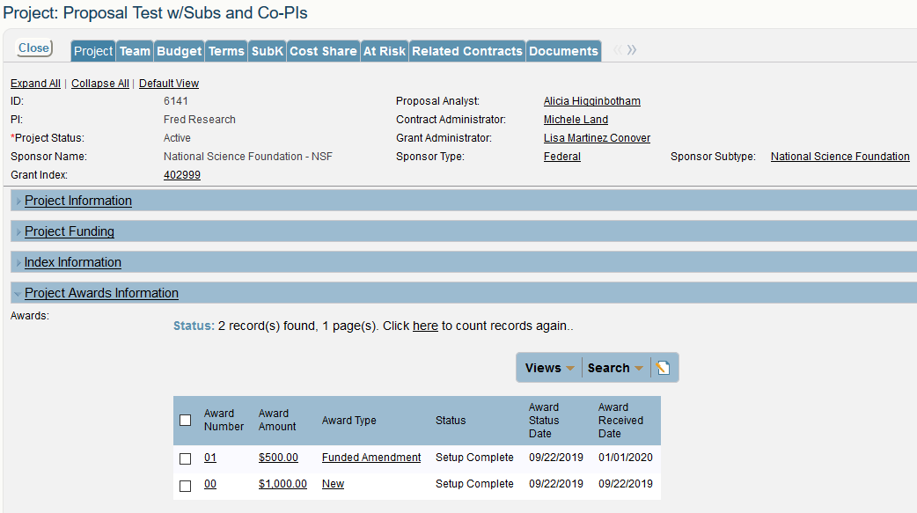
Project Award Information
Different Award Types are listed: New, Funded Amendment, NCE
Click on View/magnifying glass to drill down

Slide 14
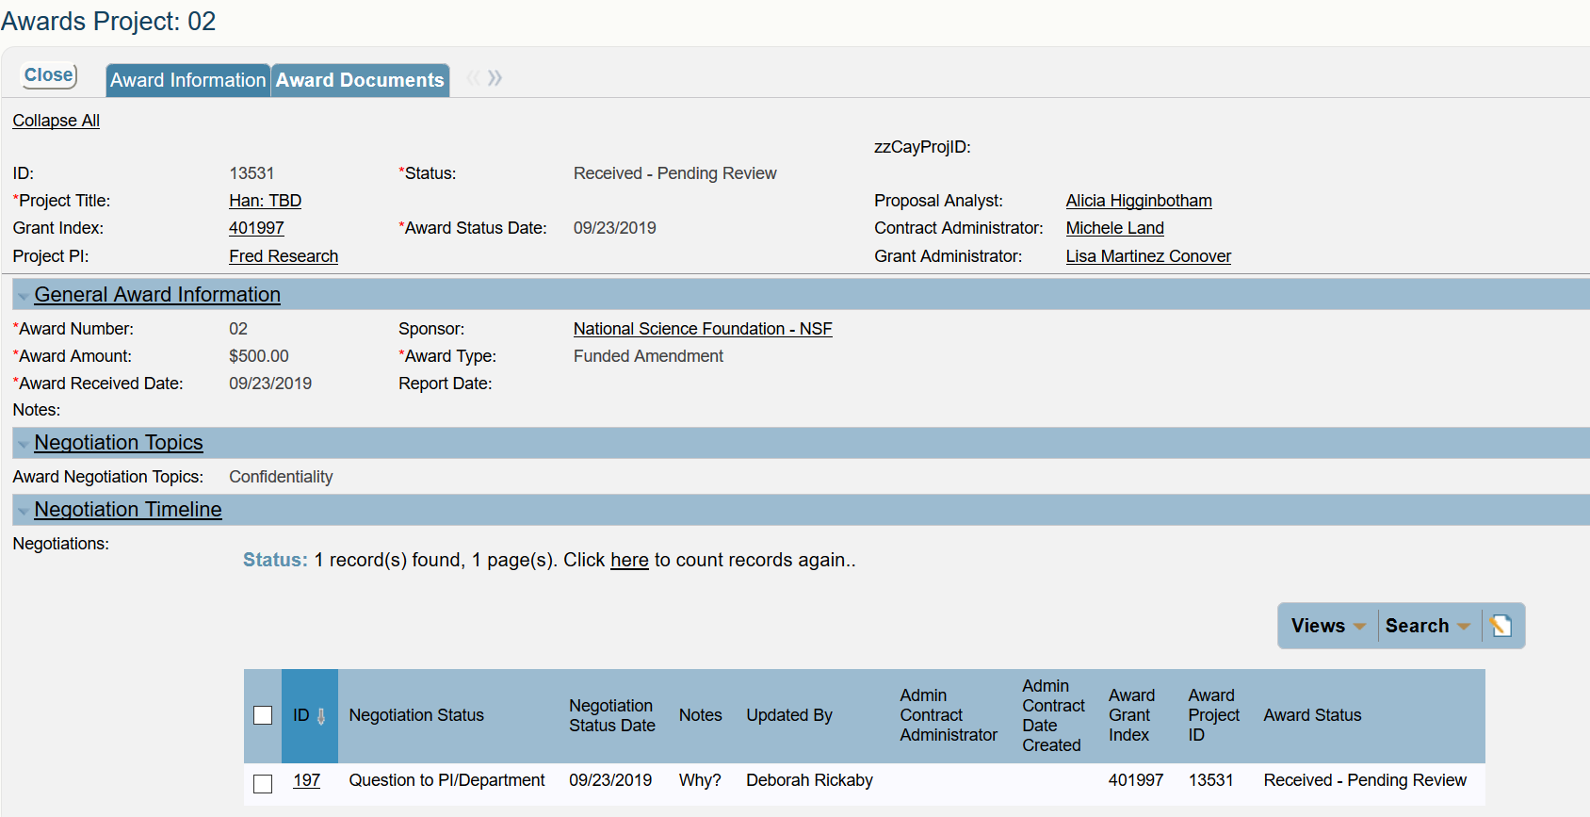
Award Information
See General Award Information for details related to the award action. This will identify the amount of funding being added, if it’s a no-cost extension, the received date, etc.

Slide 15
Award Information
View Award Information including amount, received date, type, & sponsor
View Negotiated Topics
View Status of the Negotiated Topic

Slide 16
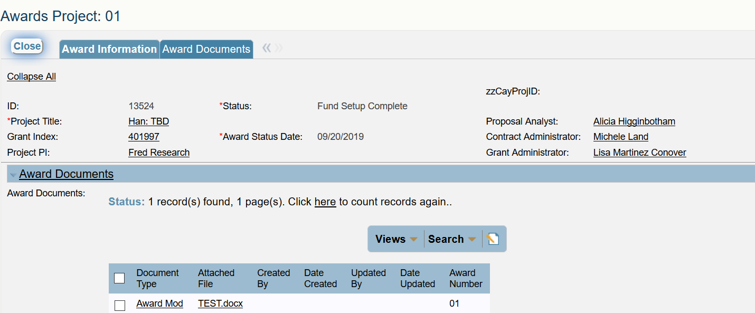
Award Documents
Directly click on the Attached File to see the uploaded document

Slide 17
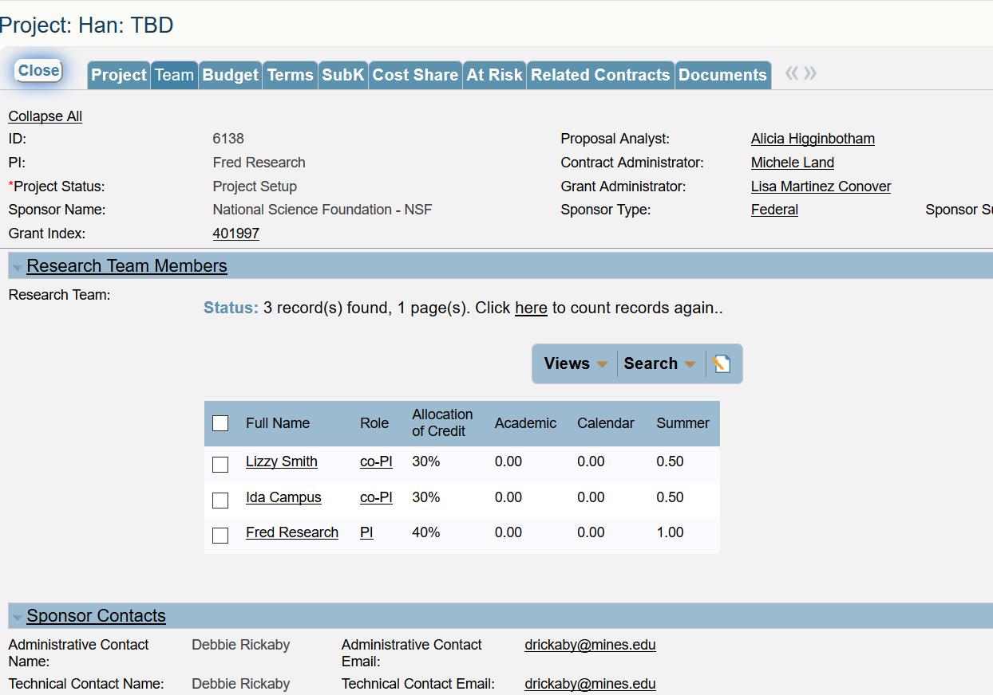
Team
Shows all Team Members & allocation of credit

Slide 18
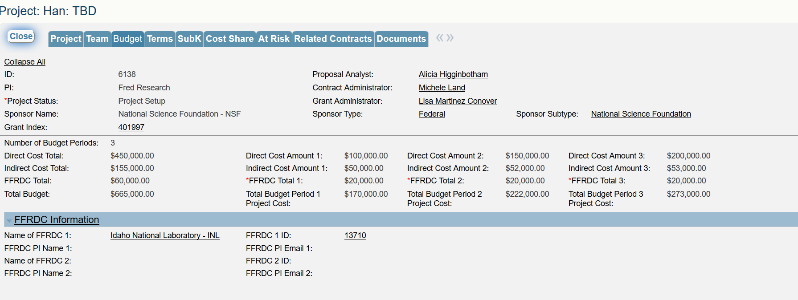
Budget
Years 1-5
Total Budget

Slide 19
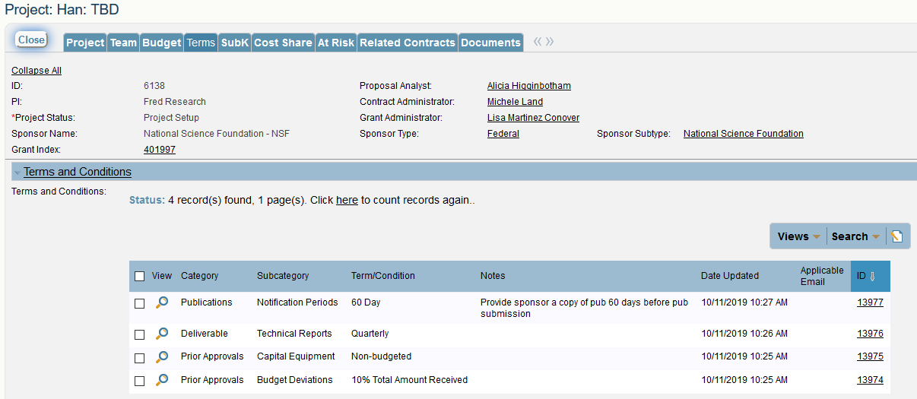
Terms

Slide 20
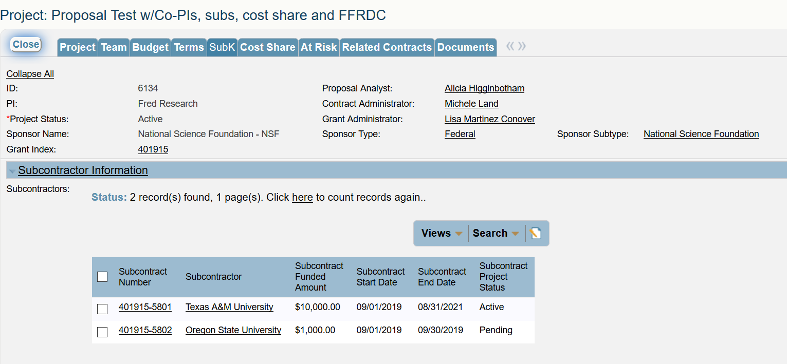
SubK
All Subcontractors on a Project are listed including funded amount, start/end dates, & status
The hyperlinked subcontract number provides more detail on each sub

Slide 21
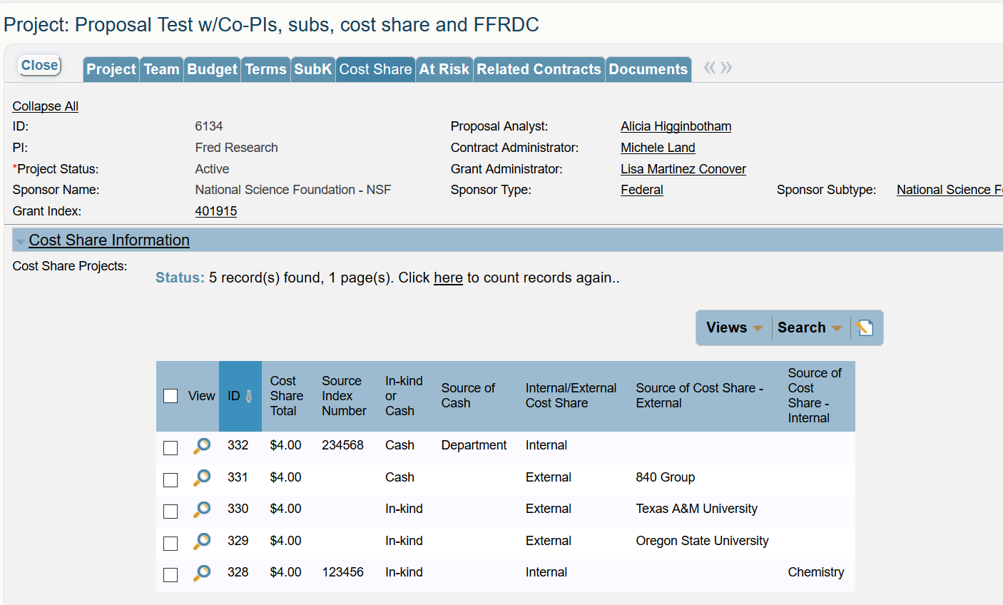
Cost Share
High level detail about cost share

Slide 22
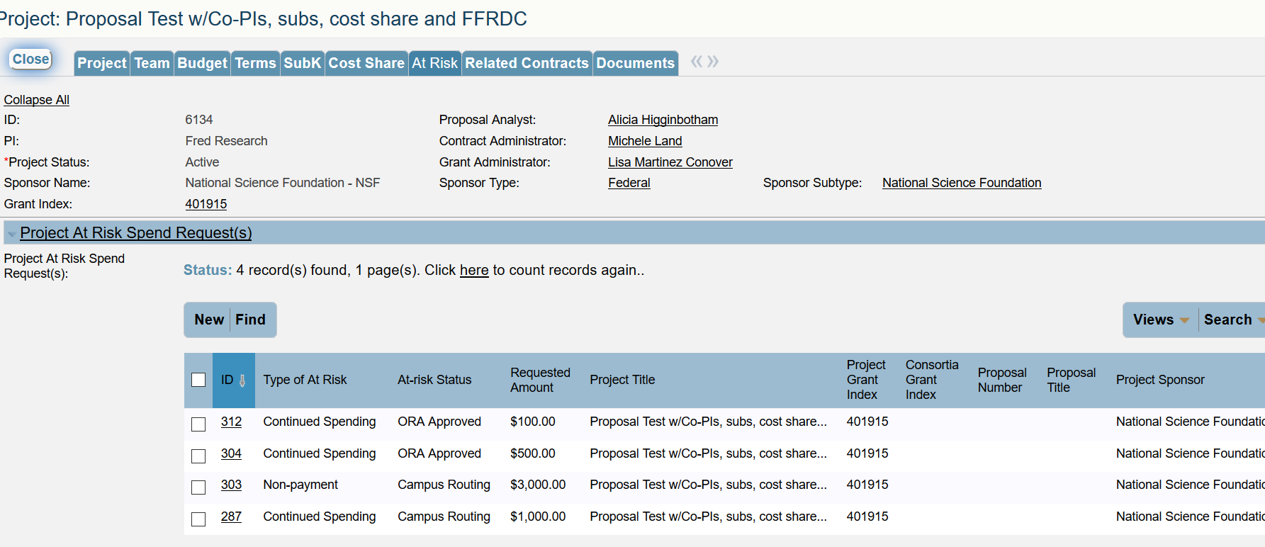
At Risk
To add an At-Risk to an existing project, click New
This action should only occur if you know more funding is coming and you have coordinated with your Contract Administrator

Slide 23
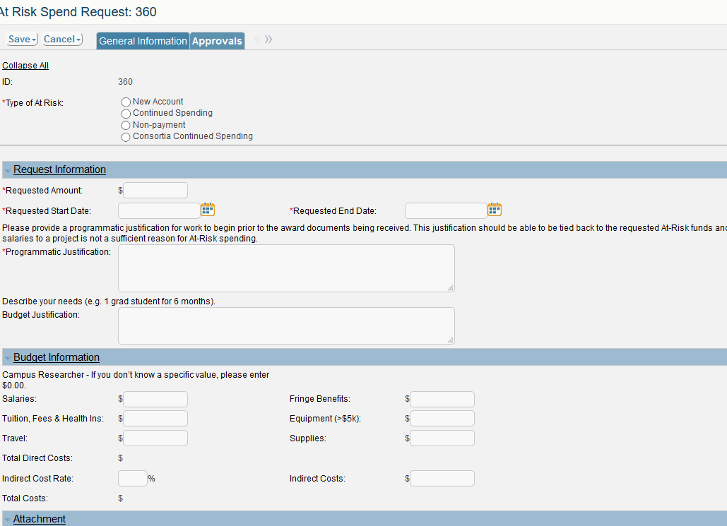
At-Risks – Needed Data

Slide 24
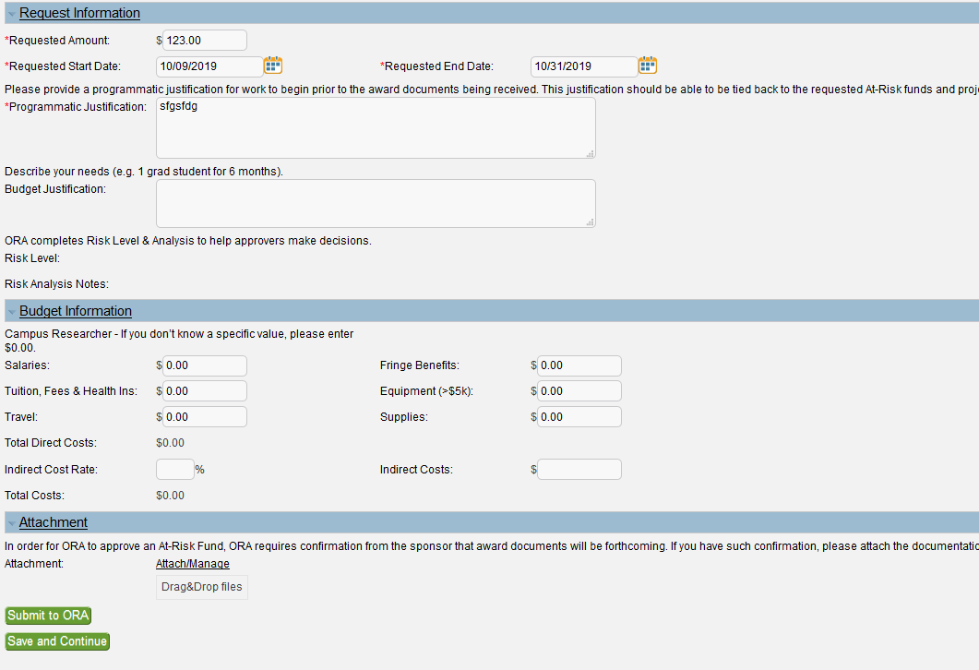
At-Risks
Submit to ORA once complete
OR
If you’ve started to load the information but are interrupted, hit Save & Continue to come back

Slide 25
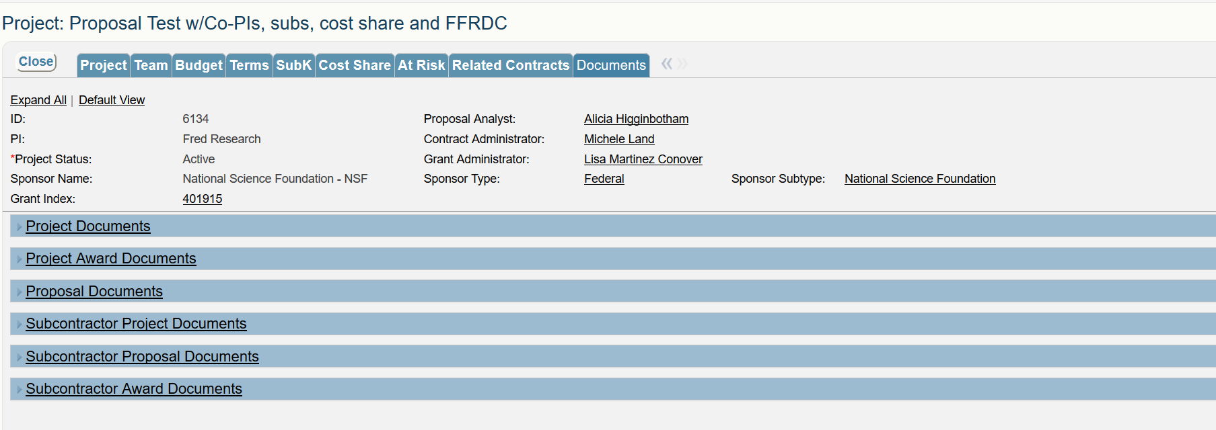
Documents
All Documents affiliated with the Project are accessible

Slide 26
Cayuse > CRS Transition
CRS launches end October
All Cayuse data will transition to CRS
Documents may not be immediately available in CRS, but ORA can email them
Banner remains financial repository for data
Once CRS is launched, Cayuse will be inactive
Watch for CRS ‘go-live’ alerts in the Daily Blast & via the Research Listserv

Slide 27
Browser Information
Works best in Firefox (fully compatible)
iPhone, iPad & Droid enabled (convenient for approvals)
Need
Javascript enabled
Cookies enabled
Pop-ups allowed

Slide 28
Questions?

Slide 29
Thanks for Coming!
More CRS trainings on ORA website
Proposals, Contracts, Post-Award, Consortia Management, Program Administrators, Walk-ins
CRS Manuals & Training Slides will post to our website! Ora.mines.edu

