Slide 1
CRS, Research, And you

Slide 2
CRS Agenda - Consortia
What is CRS?
What’s new?
How do I login?
How do I access a Consortia?
How do I find members?
Where do I view documents?
What does an invoice look like?

Slide 3
What is CRS?
CRS stands for Contract & Research System
Web-based platform for proposal & award management
Electronic proposal tracker, router and certification
Proposal & award reporting system (college, dept, center, PI, sponsor, etc.)
Banner still handles expenses & financials

Slide 4
New in Pre-Award
Generate Current & Pending Support documents
Start & route Cost Share Approvals & IDC Waivers (no more paper)
Start & route At-Risk Spend Requests (no more paper)
Track status of proposals & at-risks
New in Post-Award
Track status of projects, at-risks & sub-awards
Certify & monitor Academic Year (AY) Cost Share
View terms & conditions & reporting requirements
Approve subcontractor invoices
View award amounts & cost share
New in Consortia
Track status of consortia & consortia contracts
View improved member payment & invoice section

Slide 5
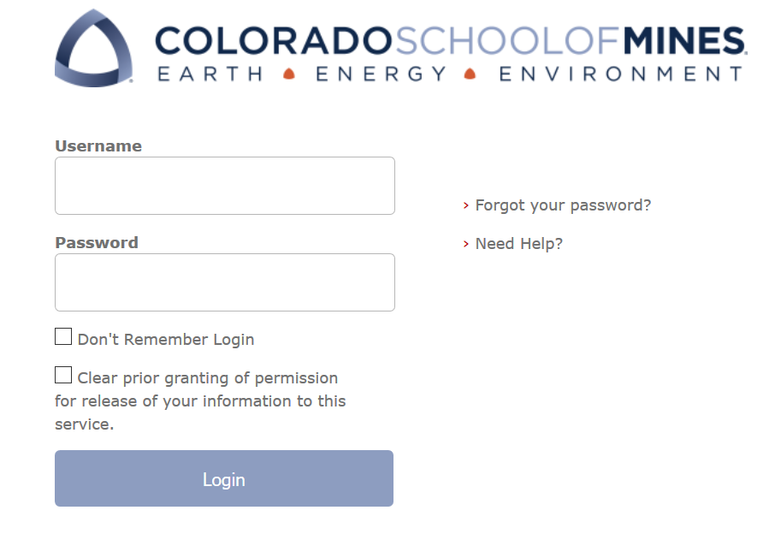
Log on Information
URL
coming soon
will be posted at ora.mines.edu
Username: Password:
Use Mines Multi-pass credentials (single sign on)

Slide 6
CRS Home Page
Research Actions
Procurement
Find CRS Data
Approvals

Slide 7
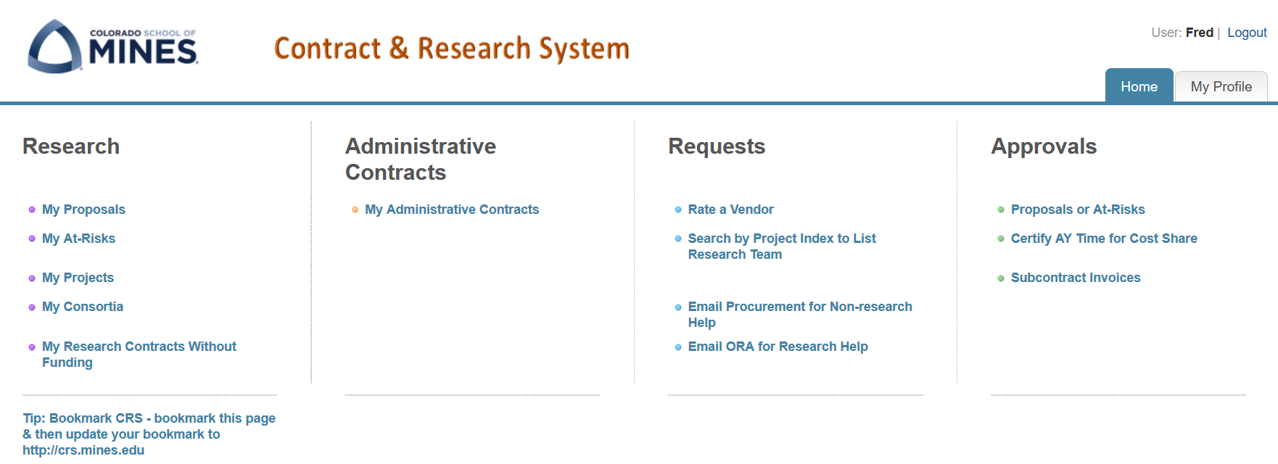
Finding Consortia

Slide 8
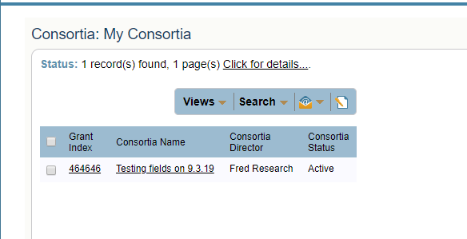
My Consortia
Grant Index
Consortia Name
Director
Status

Slide 9
Top Section – All Tabs
The top section provides a high-level summary of your Consortia

Slide 10
Consortia Information
The Consortia Information includes key fields such as:
Director
Home Department
Overhead Return Method
Administrator
IDC Rates

Slide 11
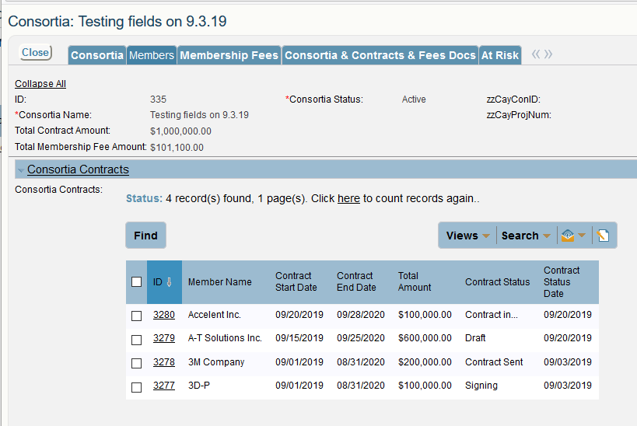
Members Tab
Lists all Members, contract status and relevant details
Click hyperlink ID to open the record for more details

Slide 12
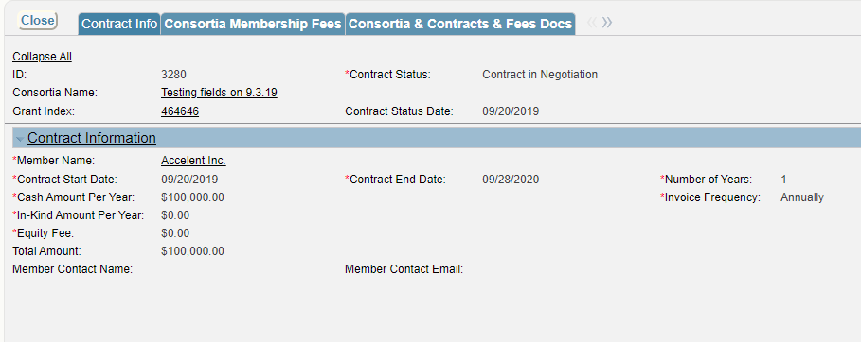
Members Tab
Information on the Member is readily available

Slide 13
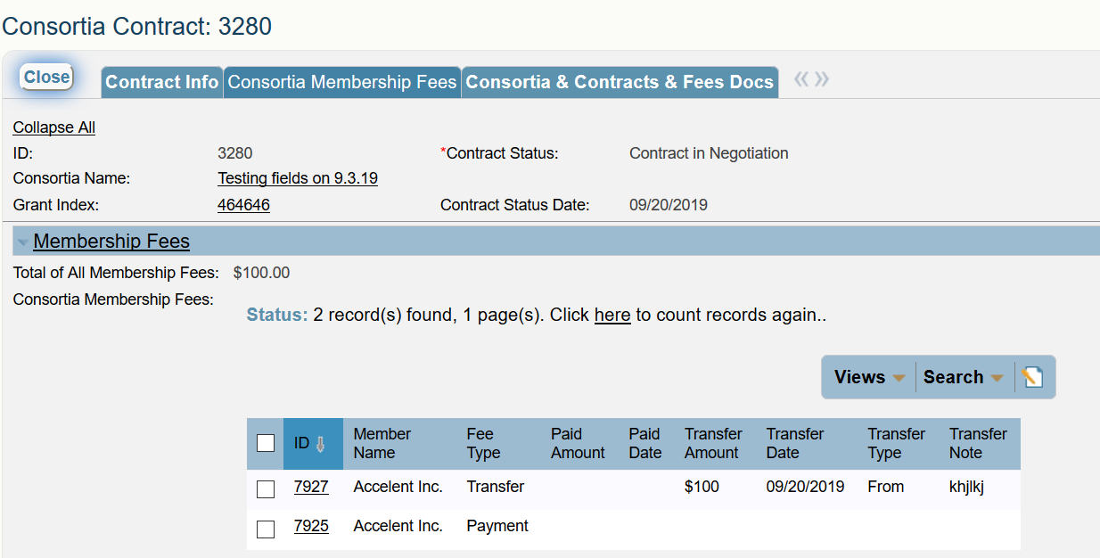
Membership Fees Tab
Find information on Fee Type by Status of: Payment / Transfer

Slide 14
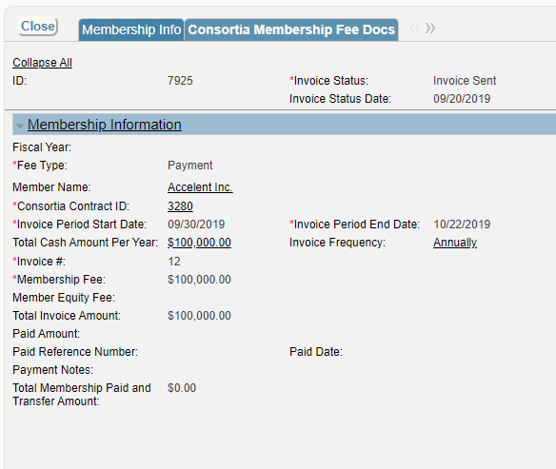
Membership Information
Invoicing and Payment information readily available!

Slide 15
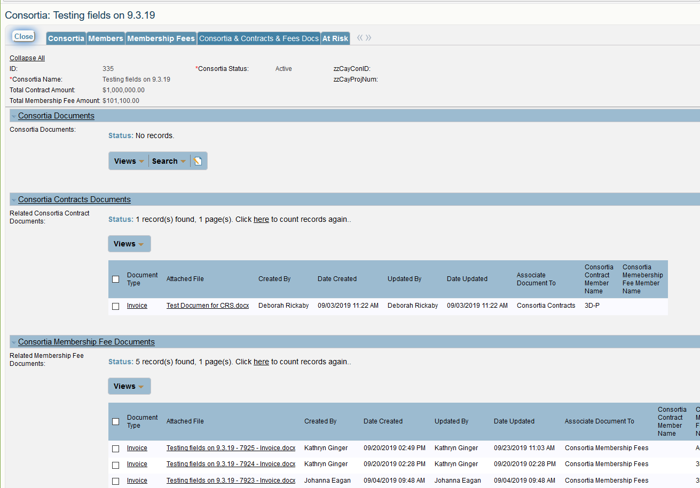
Membership Fee Docs
Directly click on the Attached File to see the uploaded document

Slide 16
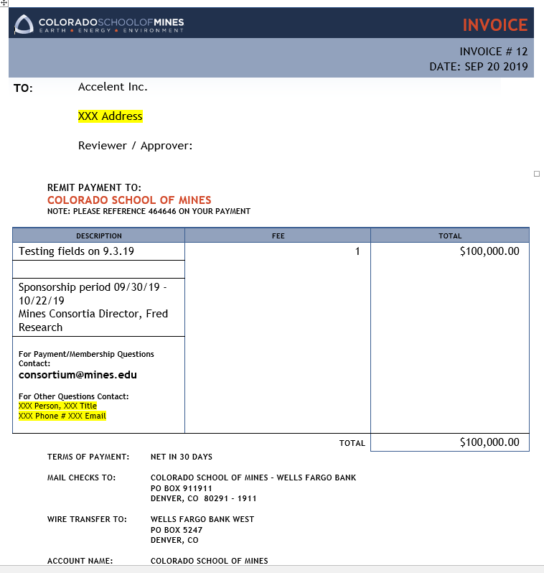
This invoice was uploaded as the Attached File on the prior Membership Fee Documents slide

Slide 17
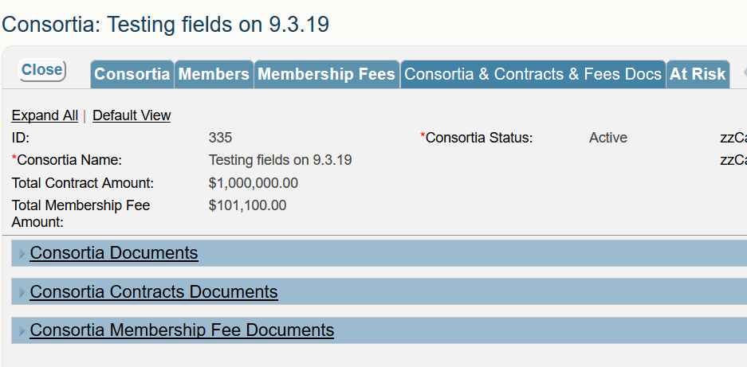
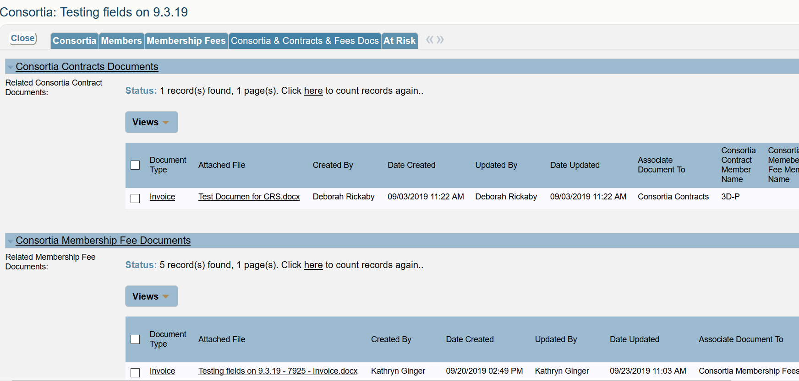
Consortia & Contracts Fees Docs
Directly click on the Attached File to see the uploaded document

Slide 18
Consortia Management
Easy access to member information
Tracking of invoicing & payments
View documents related to consortia members

Slide 19
Cayuse > CRS Transition
CRS launches end October
All Cayuse data will transition to CRS
Documents may not be immediately available in CRS, but ORA can email them
Banner remains financial repository for data
Once CRS is launched, Cayuse will be inactive
Watch for CRS ‘go-live’ alerts in the Daily Blast & via the Research Listserv

Slide 20
Browser Information
Works best in Firefox (fully compatible)
iPhone, iPad & Droid enabled (convenient for approvals)
Need
Javascript enabled
Cookies enabled
Pop-ups allowed

Slide 21
New System – Brings Change

Slide 22
Thanks for Coming!
More CRS trainings on ORA website
Proposals, Contracts, Post-Award, Consortia Management, Program Administrators, Walk-ins
CRS Manuals & Training Slides will post to our website! Ora.mines.edu

