Slide 1

CRS, Research,
And you

Slide 2
CRS Agenda – Program Administrators (who rule the world)
What is CRS?
What’s new?
How do I login?
How do I know the status?
How can I search for research in my Center/Department?
How do I help faculty find an index?
Exporting Searches
Approvals – for when Center Directors/Dept Heads are out of office

Slide 3
What is CRS?
CRS stands for Contract & Research System
Web-based platform for proposal & award management
Electronic proposal tracker, router and certification
Proposal & award reporting system (college, dept, center, PI, sponsor, etc.)
Banner still handles expenses & financials

Slide 4
New in Pre-Award
  Generate Current & Pending Support documents
  Start & route Cost Share Approvals & IDC Waivers (no more paper)
  Start & route At-Risk Spend Requests (no more paper)
  Track status of proposals & at-risks
New in Post-Award
  Track status of projects, at-risks & sub-awards
  Certify & monitor Academic Year (AY) Cost Share
  View terms & conditions & reporting requirements
  Approve subcontractor invoices
  View award amounts & cost share
New in Consortia
  Track status of consortia & consortia contracts
  View improved member payment & invoice section

Slide 5
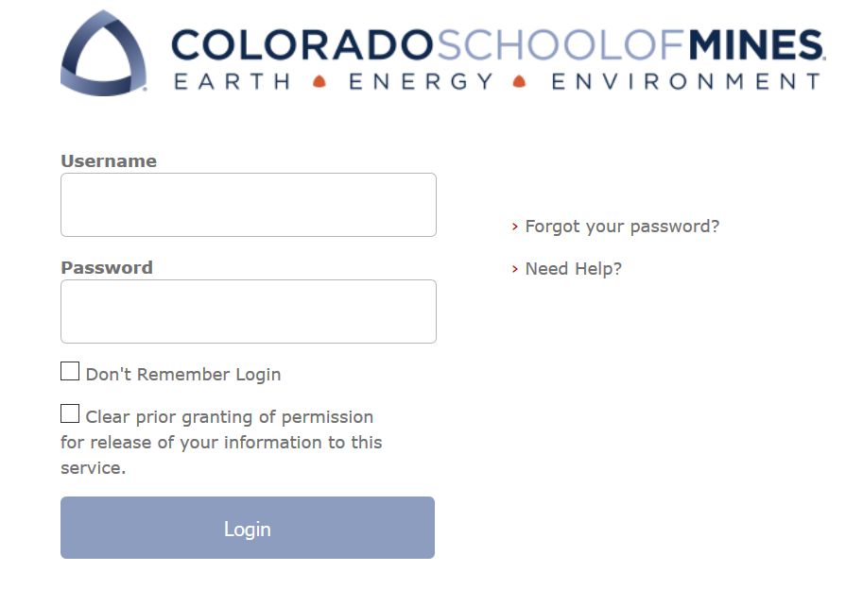
Log on Information
URL
coming soon
will be posted at ora.mines.edu
Username: Password:
Use Mines Multi-pass credentials (single sign on)

Slide 6
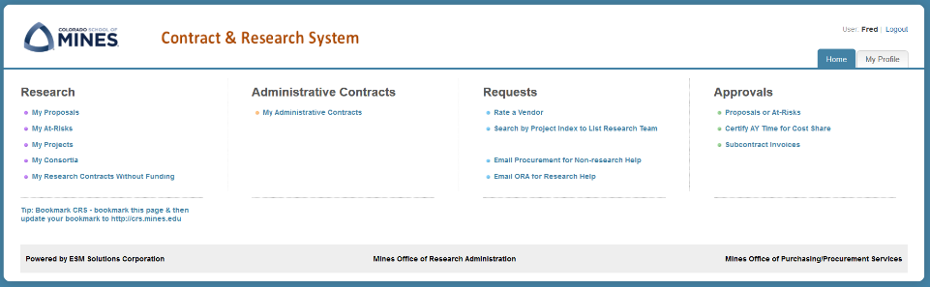
CRS Home Page
Research Actions
Procurement
Find CRS Data
Approvals

Slide 7
What’s the Status of our Faculty’s Research?

Slide 8
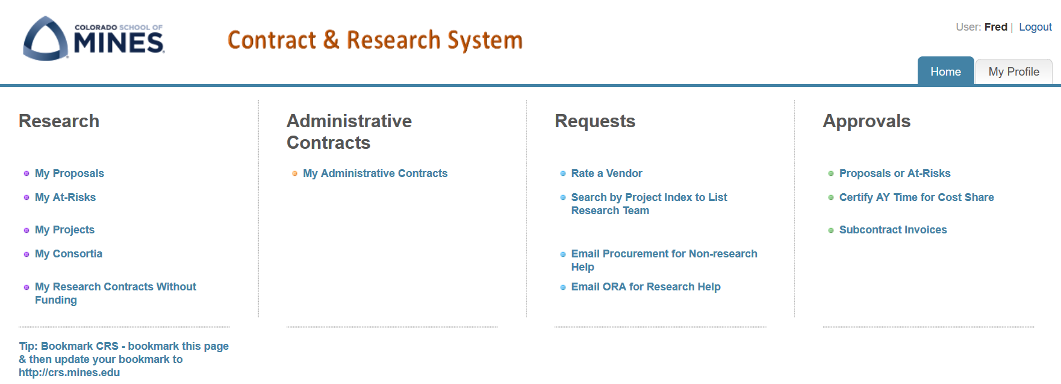
Finding Statuses
Statuses are located in each of the ‘Research’ sections
Each section allows you to search by multiple variables
Search functions work the same on each tab; the next slides walk you through searching in Proposals

Slide 9
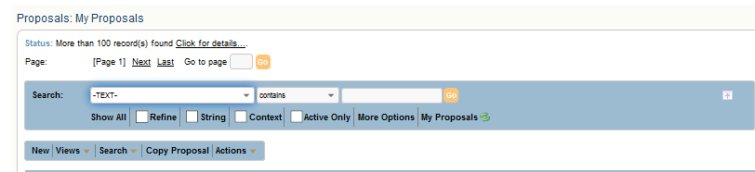
Perform a Search to find Status
The Search bar contains multiple fields in the proposals table located in the drop down menu.
Key Fields to search on:
PI Last Name
PI Full Name
Proposal Title
Sponsor
Admin/IDC Center Name
Admin/IDC Department Name
Status

Slide 10
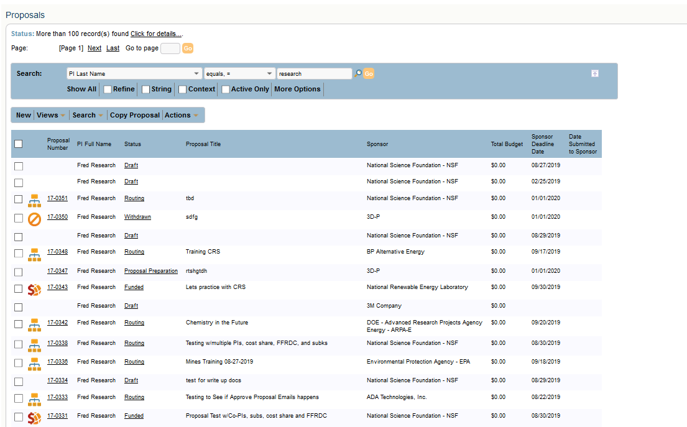
Search Results: PI Last Name
Notes:
Talking Points:
-Search function applies to Projects and At-Risks

Slide 11
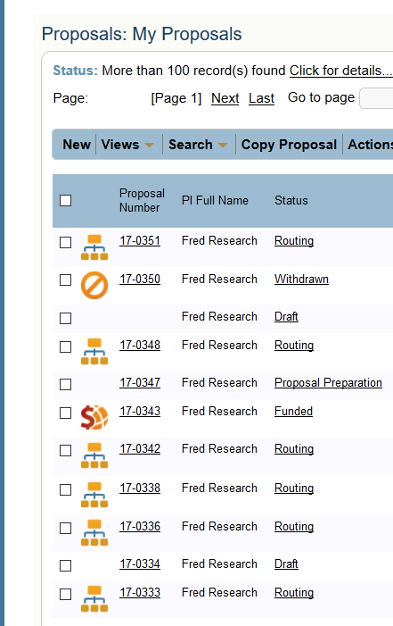
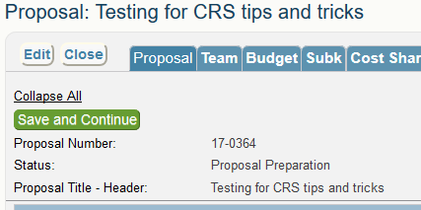
My Proposals: Status
Statuses are:
Draft
Proposal Preparation
Routing
Funded
Withdrawn
Not Submitted
Not Funded

Slide 12
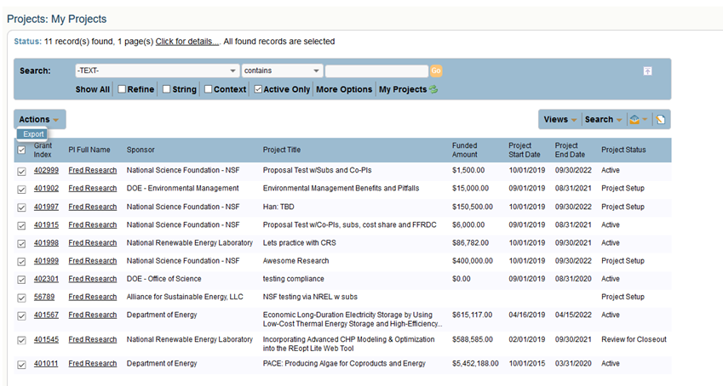
My Projects: Status
Project Statuses are:
Project Setup
Active
Review for Closeout
Closed
Notes:
Talking point:
- Transition point: If the project is in “Project Setup” how do I know where its at?..... Answer: Look at the Award status!

Slide 13
My Awards: Status
Click on the Grant Index to drill down to find information about an Award action.
Award actions = new agreements, funded amendments, extensions, etc.

Slide 14
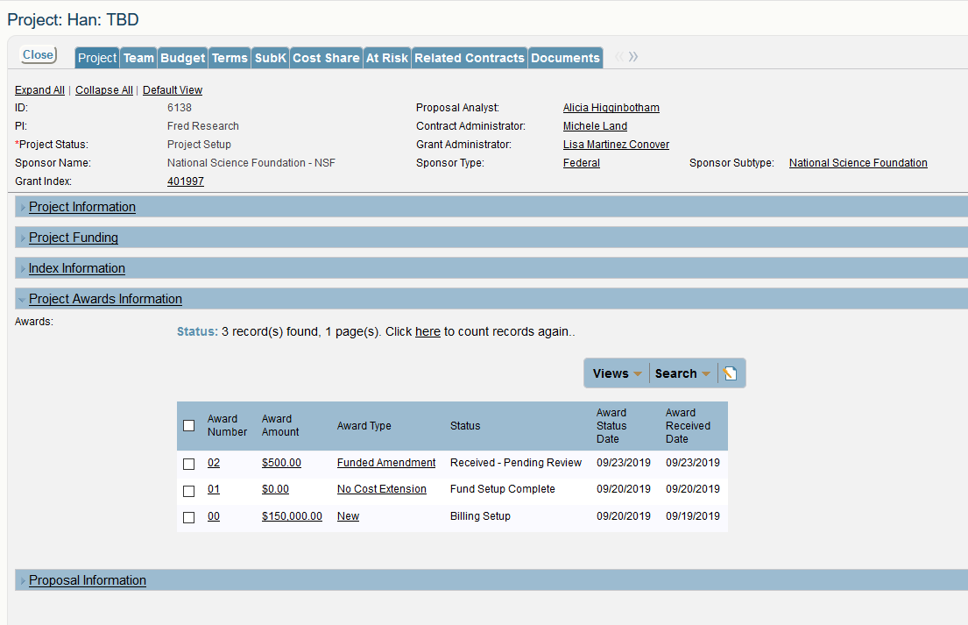
My Awards: Status
Example Award Statuses are:
Received-Pending Review
In Review
In Negotiations
Hold for Compliance
Signing
Signing Complete
Pending Banner Setup
Fund Setup Complete
Setup Complete
Notes:
Talking Point-
- Mention the status dates!!!

Slide 15
But Can I Search for Research in my Center/Department?

Slide 16
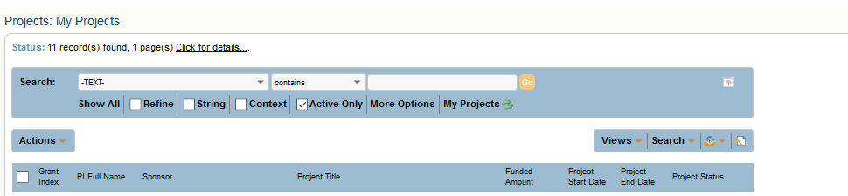
Research in my Center / Department
Use the Search drop down menu to search by:
Admin/IDC Center Name OR
Admin/IDC Department Name

Slide 17
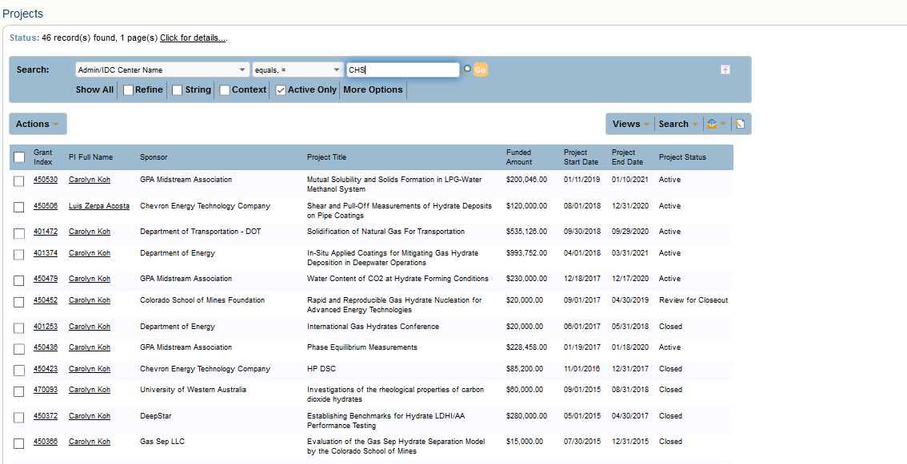
Search Results: Center/Department Research
In this search by Admin/IDC Center Name, equals, CHS –
Over 46 projects were returned
Hyperlinked Fields - PI Full Name & Grant Index take you into the record
Project Status – active, closed, review for closeout
Notes:
Columns can be sorted numerically/alphabetically

Slide 18
Is There an Index for That?

Slide 19
How do I find an index?
Grant Indexes show when you perform a search

Slide 20
What are the details of the Project?

Slide 21
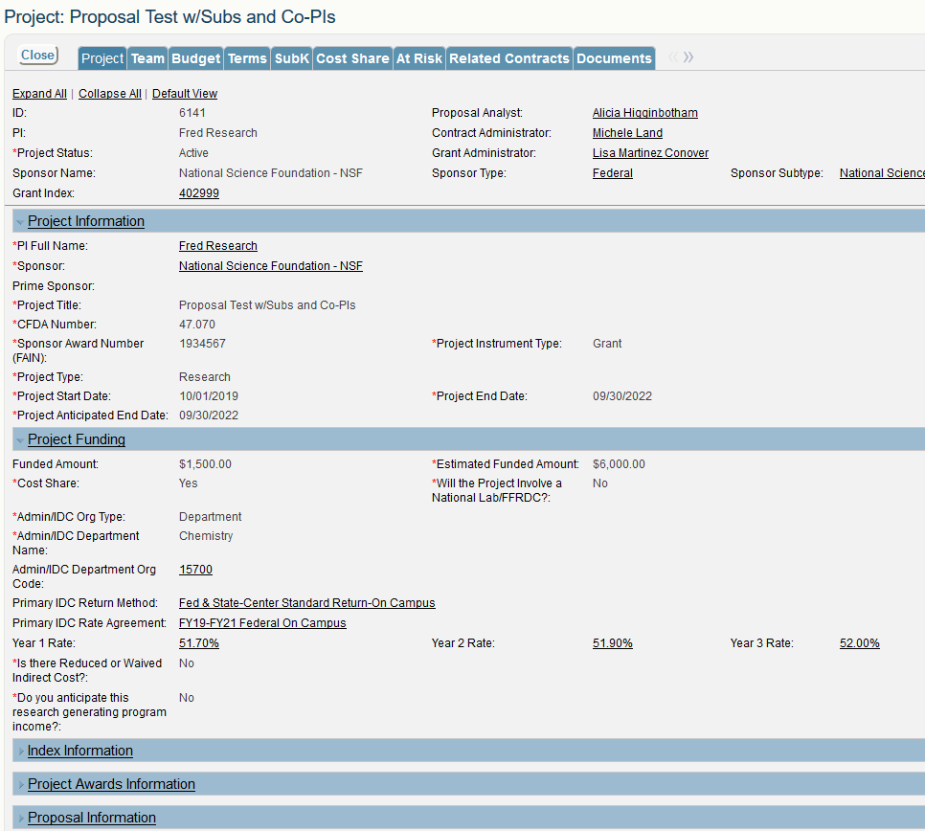
Notes:
Talking point:
- New estimated end that will let us know if the project is intended to past the current budget year
- Estimated funded amount – if we are incrementally funded the anticipated full project amount will show here.

Slide 22
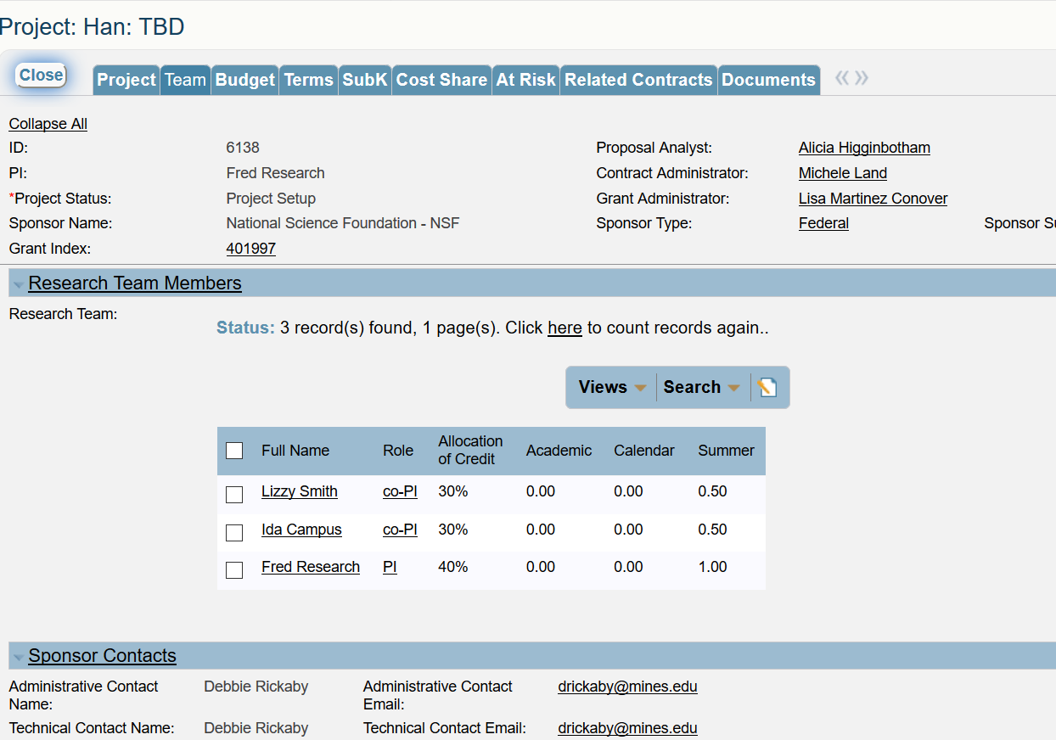
Team
Shows all Team Members & allocation of credit

Slide 23
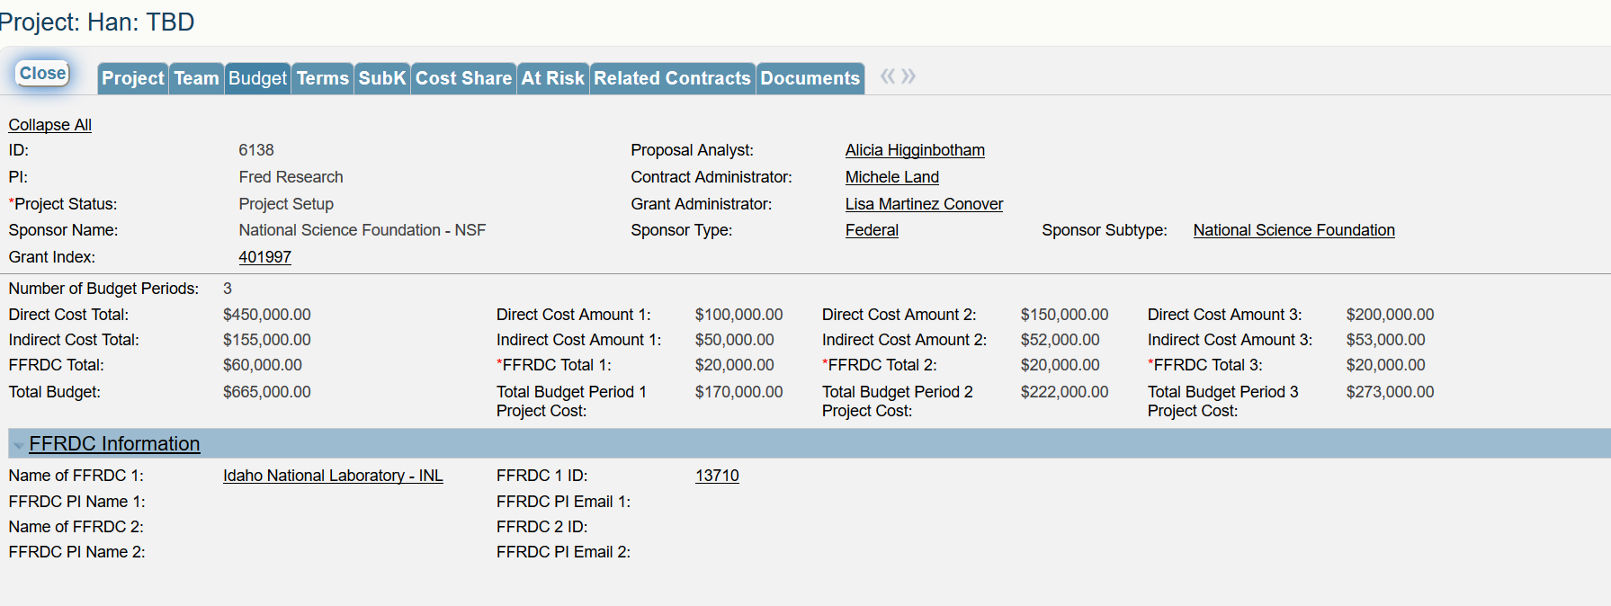
Budget
Years 1-5
Total Budget
Notes:
High level budget details; uploaded budget in documents section

Slide 24
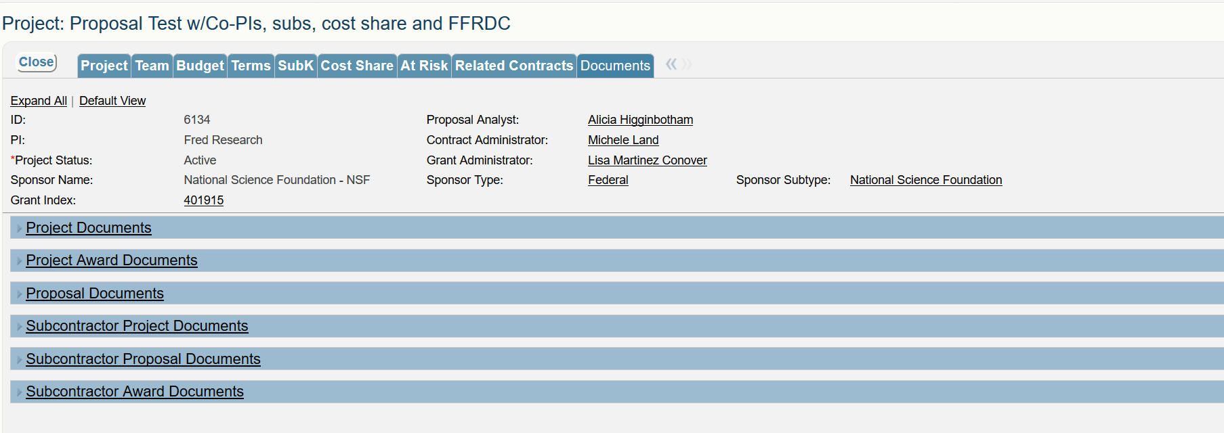
Documents
All Documents affiliated with the Project are accessible

Slide 25
Can I Export that Information?

Slide 26
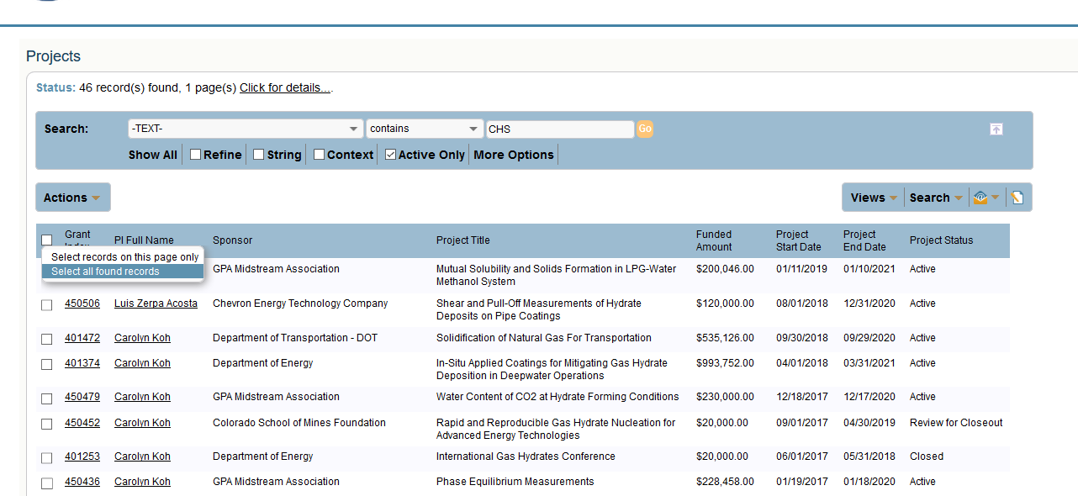
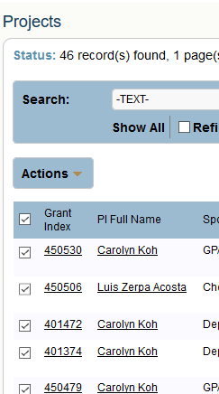
Export Results to Excel
Hover over the little box; select all found records
All records will have their box ticked

Slide 27
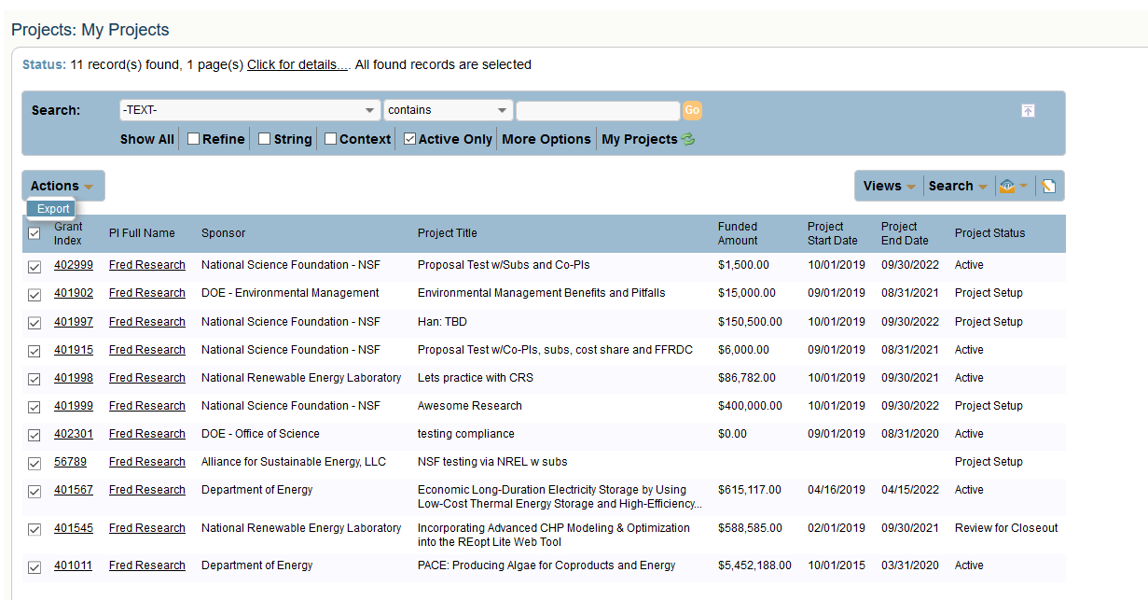
Export Results to Excel
When all boxes are ticked, click Export under Actions

Slide 28
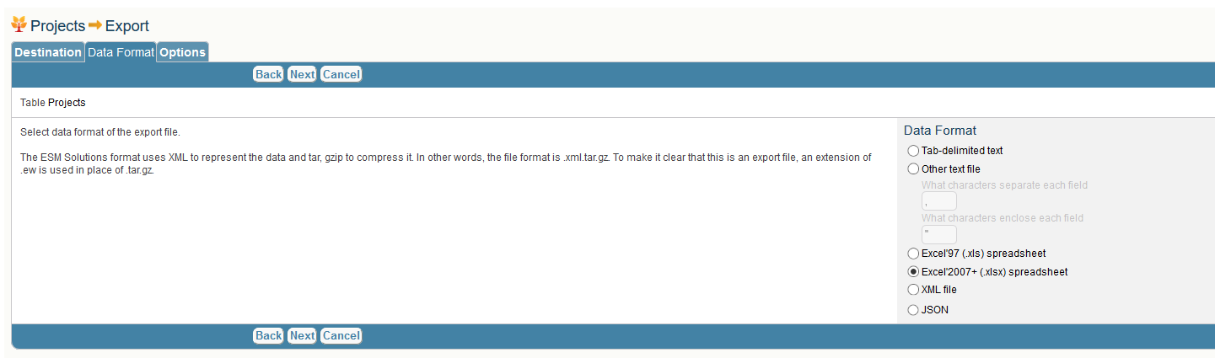
Export Results to Excel

Slide 29
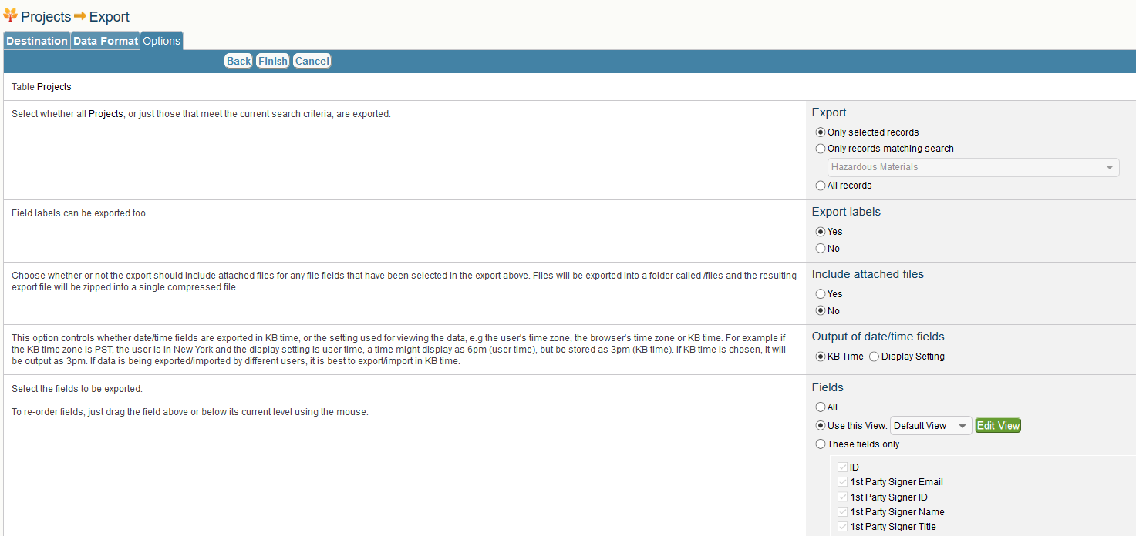
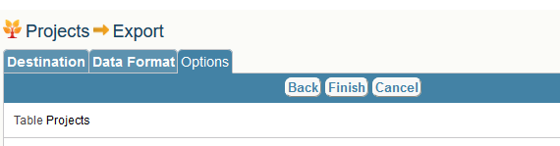
Export Results to Excel
Be sure to check this box!!
And this one or you will return too many fields
CRS will export the data for download to Excel

Slide 30
What About At-Risks?

Slide 31
At-Risks
If a PI knows an award is coming, it is possible to request an At-Risk on a Proposal
If a PI has an active project and knows supplemental funding is coming, then it is possible to request an At-Risk on a Project
Steps -
Use the above search options to find the appropriate proposal OR project
Proposal – click on Proposal Number
Project – click on Grant Index

Slide 32
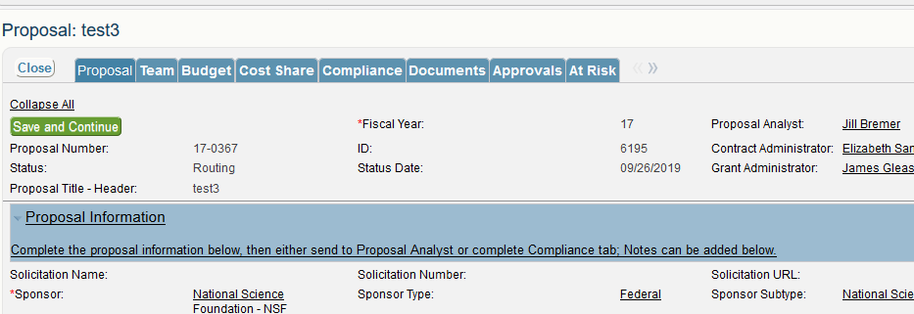
At-Risks - Proposal
If a PI knows an award is coming, it is possible to request an At-Risk on a Proposal
If a PI has an active project and knows supplemental funding is coming, then it is possible to request an At-Risk on a Project

Slide 33
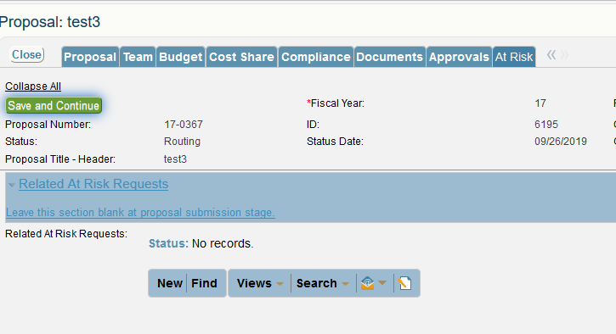
At-Risks - Proposal

Slide 34
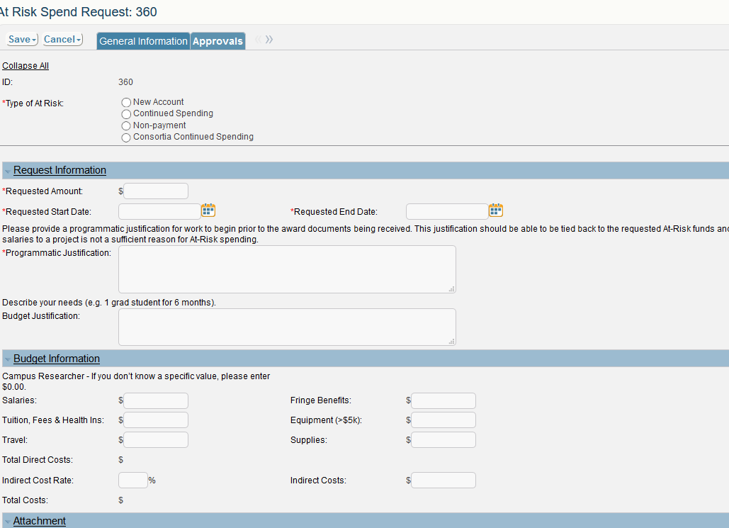
At-Risks – Required Info

Slide 35
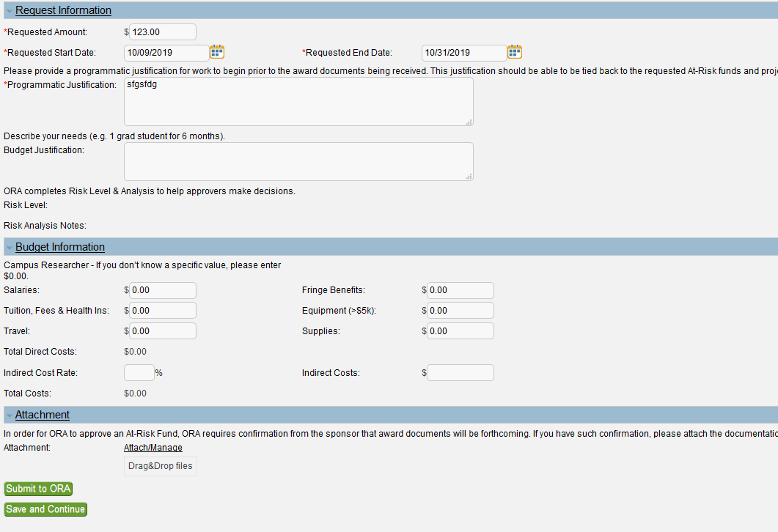
At-Risks
Submit to ORA once complete
OR
If you’ve started to load the information but are interrupted, hit Save & Continue to come back to it at a later time

Slide 36
At-Risk Approvals – PI, Center & Dept Heads
Notes:
Program Admins can request At-Risks on behalf of faculty but cannot complete the approval process; approval emails would be sent by CRS

Slide 37
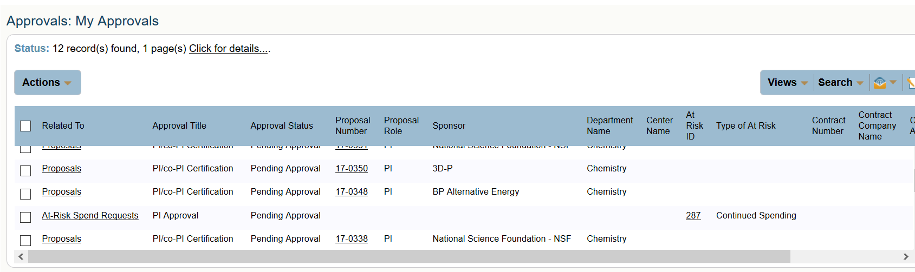
Approvals - PI, Center & Dept Heads
Related To: shows Proposals & At-Risk Spending Requests in the PI’s queue
Approval Title: Identifies if you are approving as
  PI (either PI/co-PI or PI Approval)
  Center Director or Dept Head (Unit Approver)
Clicking on a hyperlink takes you into the proposal for review

Slide 38
But My Department Head is Going on Sabbatical for the next 5 years!

Slide 39
Re-directing Approvals
Center Directors AND Department Heads have the ability to set a different approver for a period of time
This is beneficial for when they are out of the office on travel and/or vacation

Slide 40

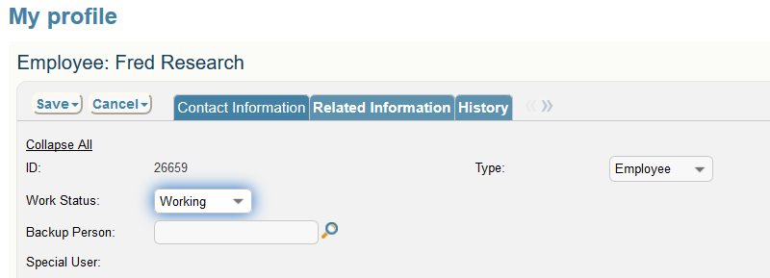
Re-directing Approvals

Slide 41

Re-directing Approvals
Designate a backup person once, the system will remember through the date provided!

Slide 42
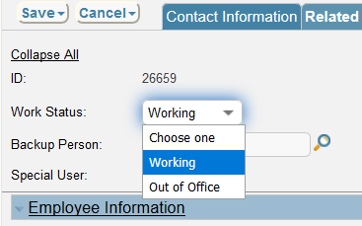
Re-directing Approvals

Slide 43
Cayuse > CRS Transition
CRS launches end October
All Cayuse data will transition to CRS
  Documents may not be immediately available in CRS, but ORA can email them
  Banner remains financial repository for data
Once CRS is launched, Cayuse will be inactive
Watch for CRS ‘go-live’ alerts in the Daily Blast & via the Research Listserv

Slide 44
Browser Information
Works best in Firefox (fully compatible)
iPhone, iPad & Droid enabled (convenient for approvals)
Need
Javascript enabled
Cookies enabled
Pop-ups allowed

Slide 45
Questions?

Slide 46
Thanks for Coming!
More CRS trainings on ORA website
  Proposals, Contracts, Post-Award, Consortia Management, Program Administrators, Walk-ins
CRS Manuals & Training Slides will post to our website! Ora.mines.edu

